Slide 1

Tunnelling Basics. Scanners
SSL/TLS Tor – Onion Routing
Wireguard/MLS/VPN/IPSec Prof Bill Buchanan OBE http://asecuritysite.com/tunnelling

Slide 2
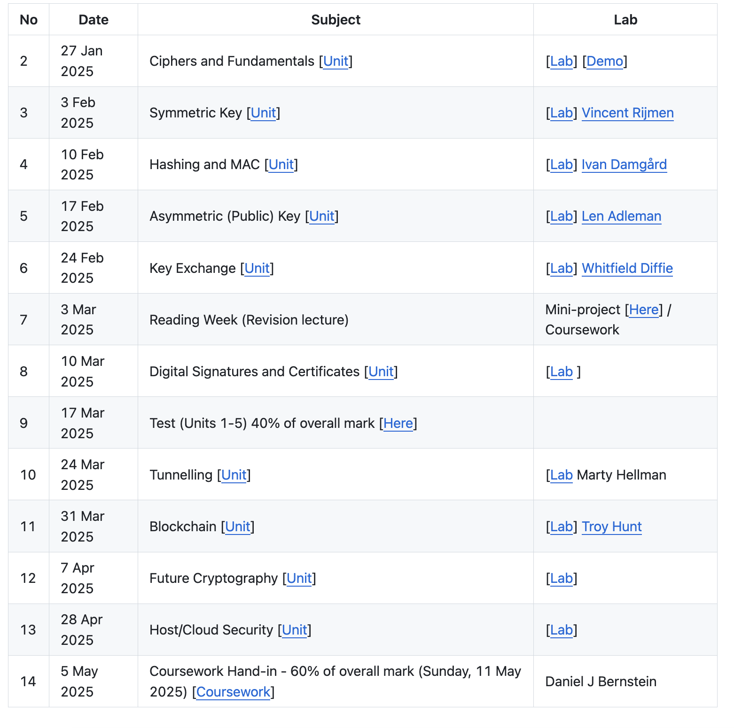
Overview

Slide 3
Tunnelling

Slide 4
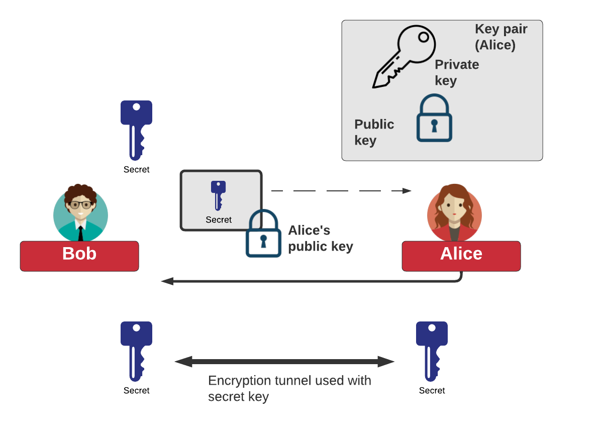
Tunnelling

Slide 5
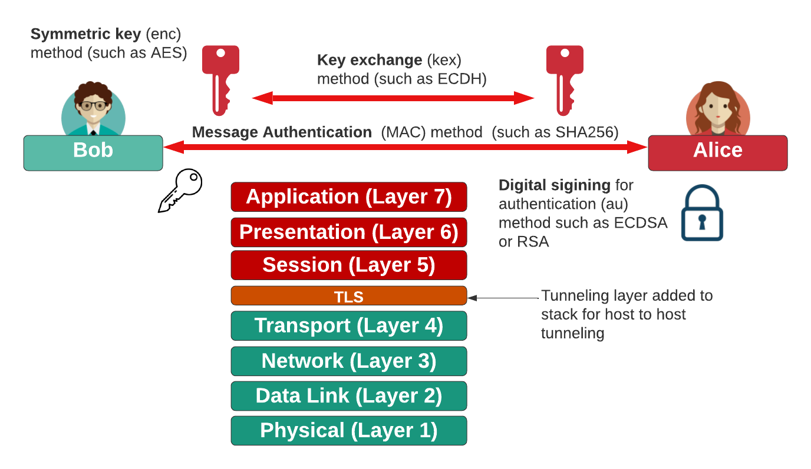
Tunnelling

Slide 6
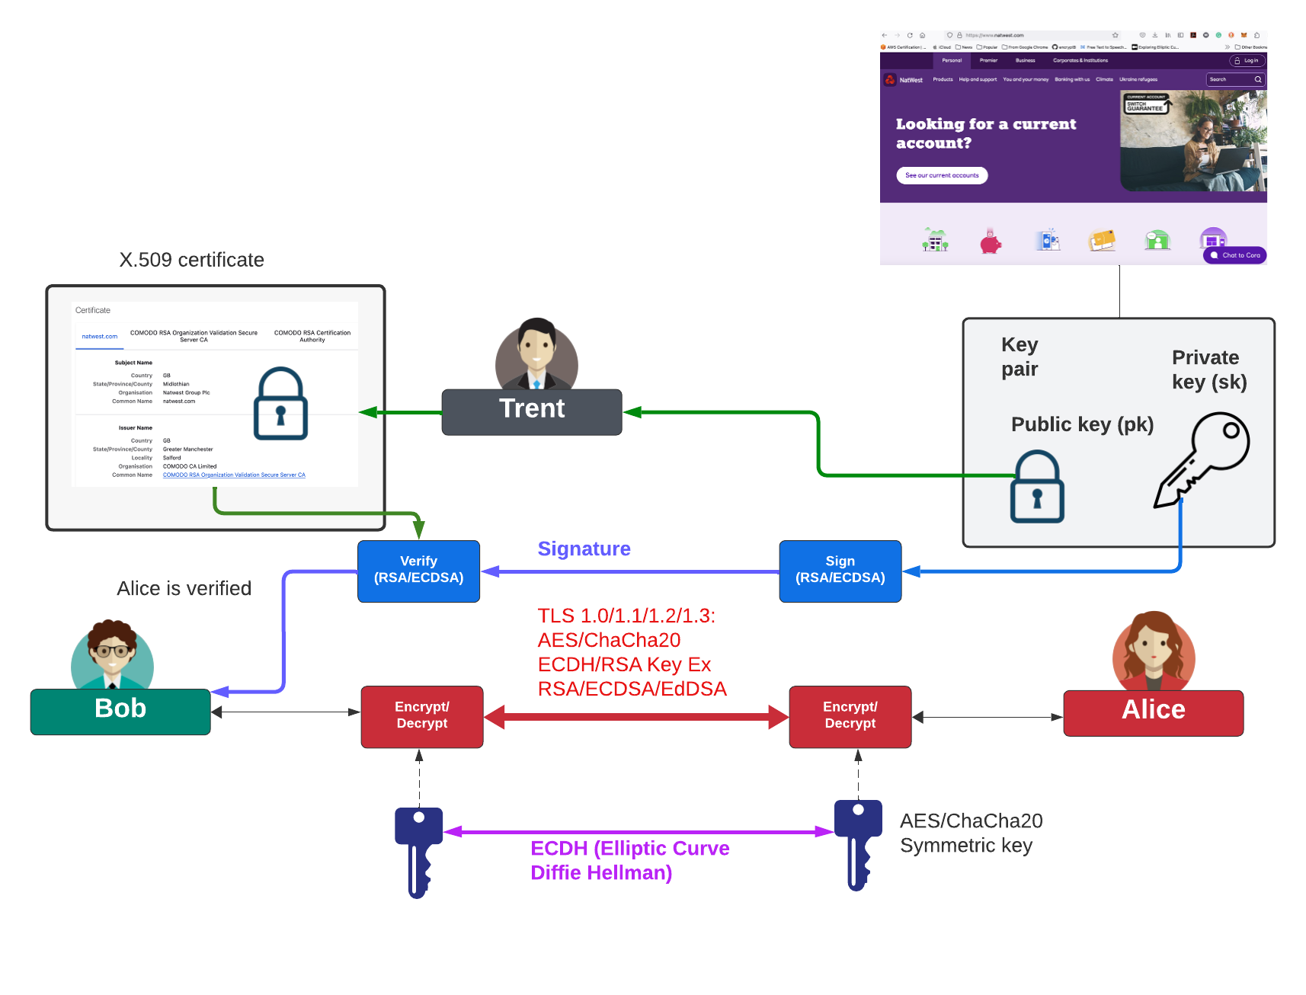
Tunnelling

Slide 7
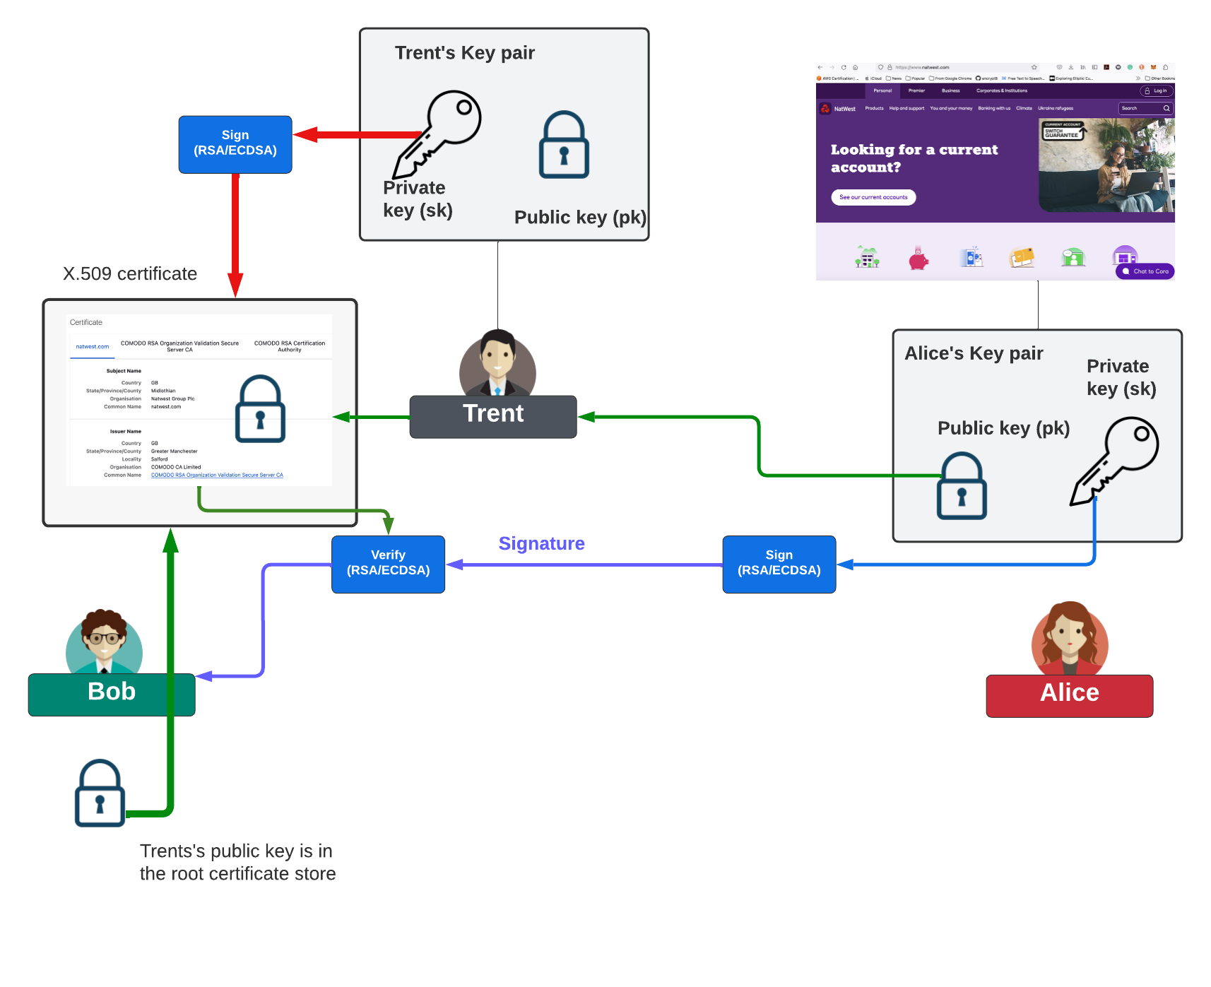
Tunnelling

Slide 8
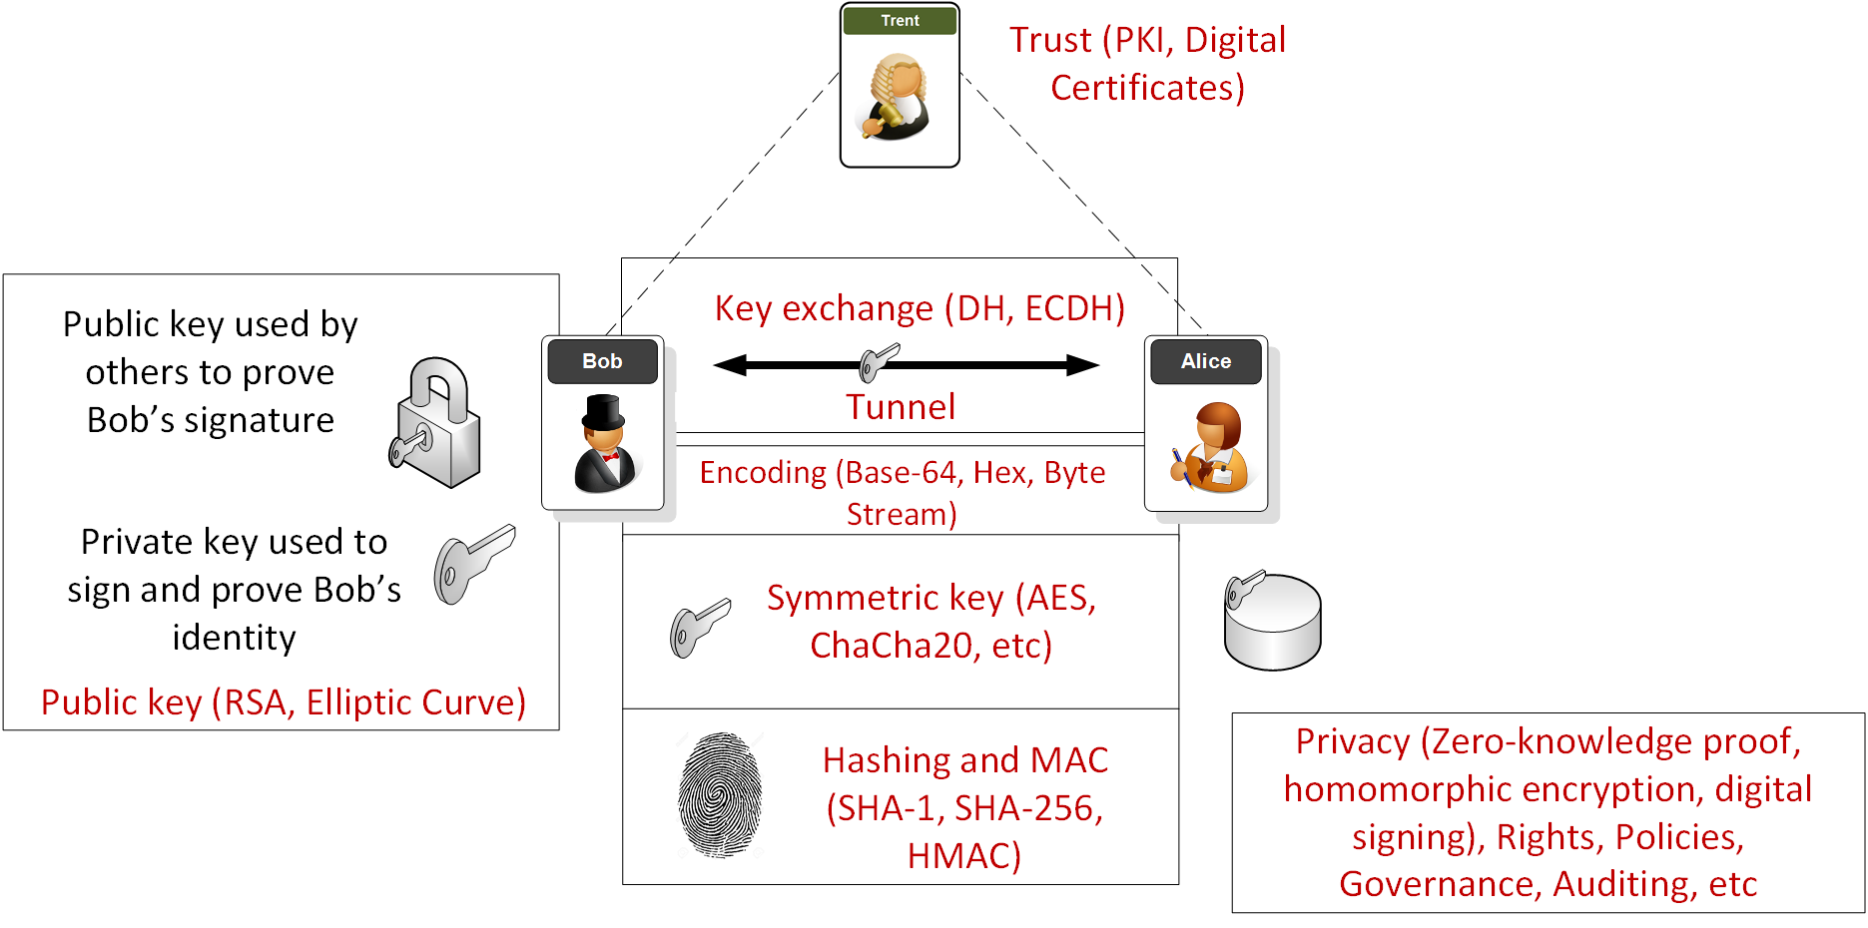
Overview

Slide 9
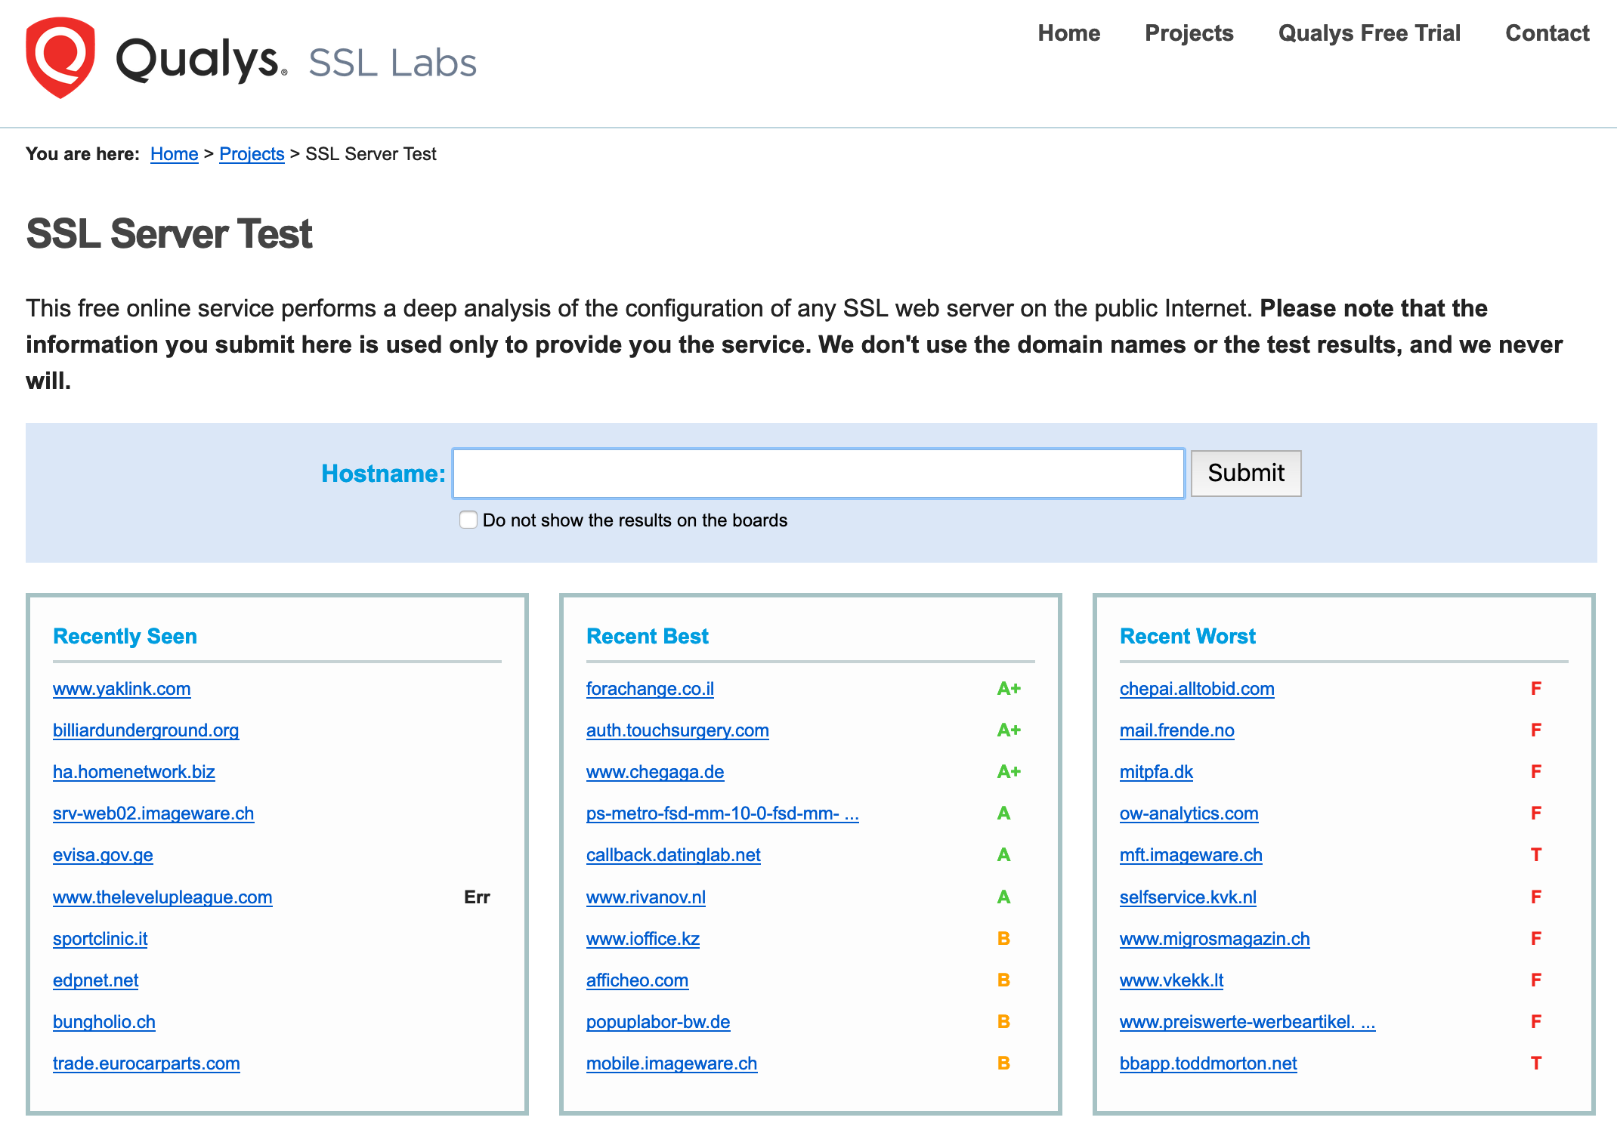
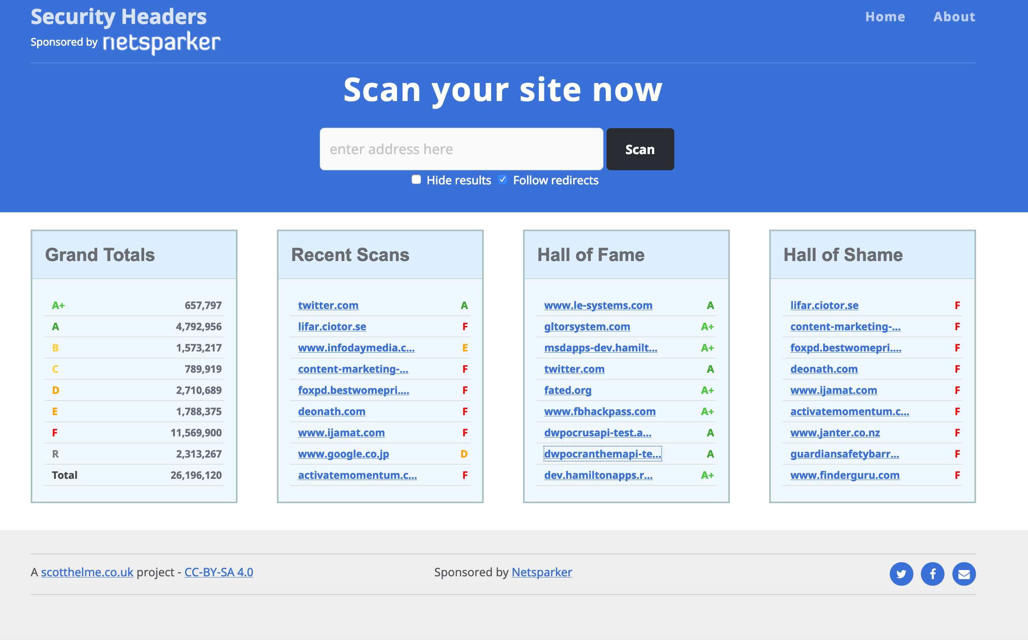

Slide 10
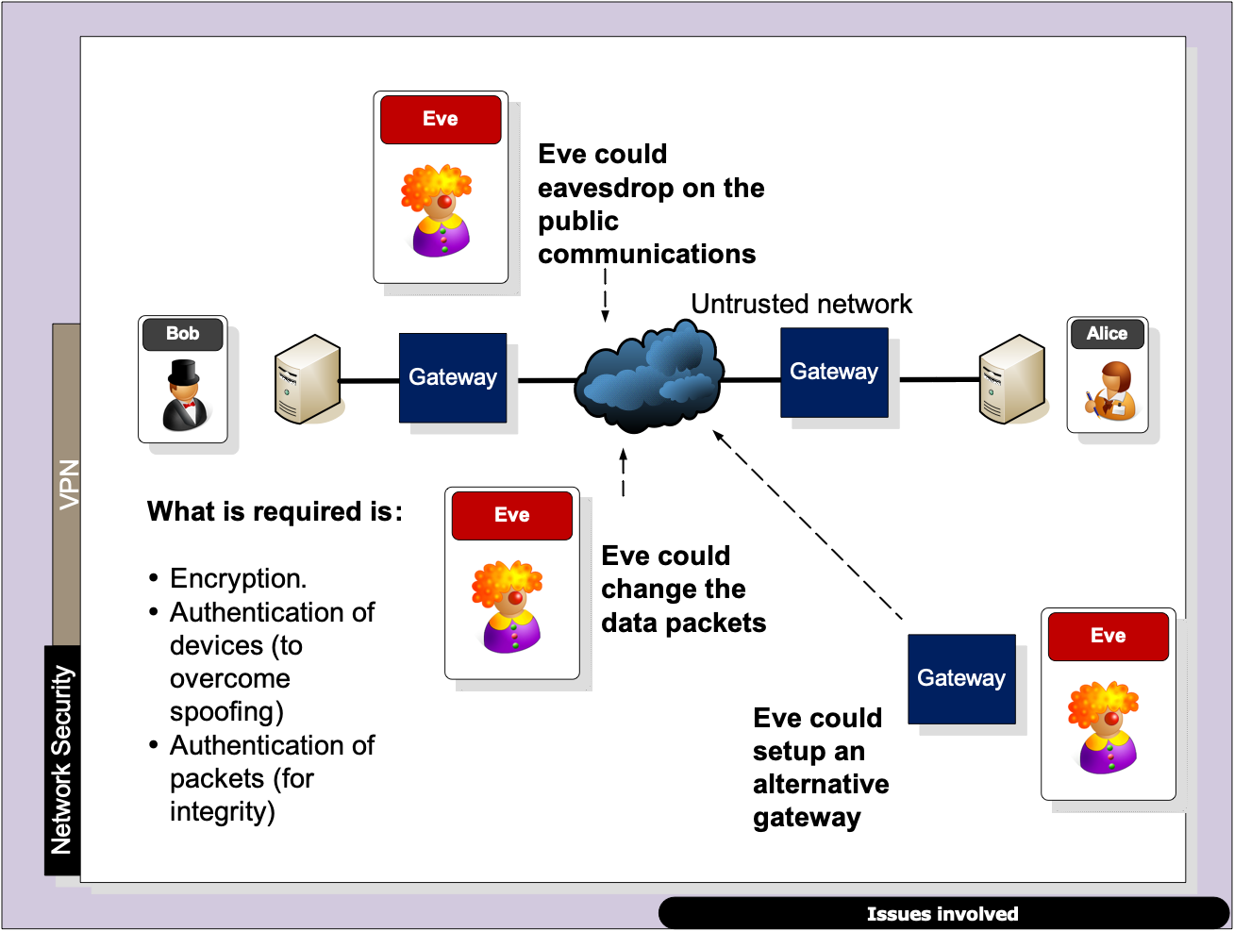

Slide 11
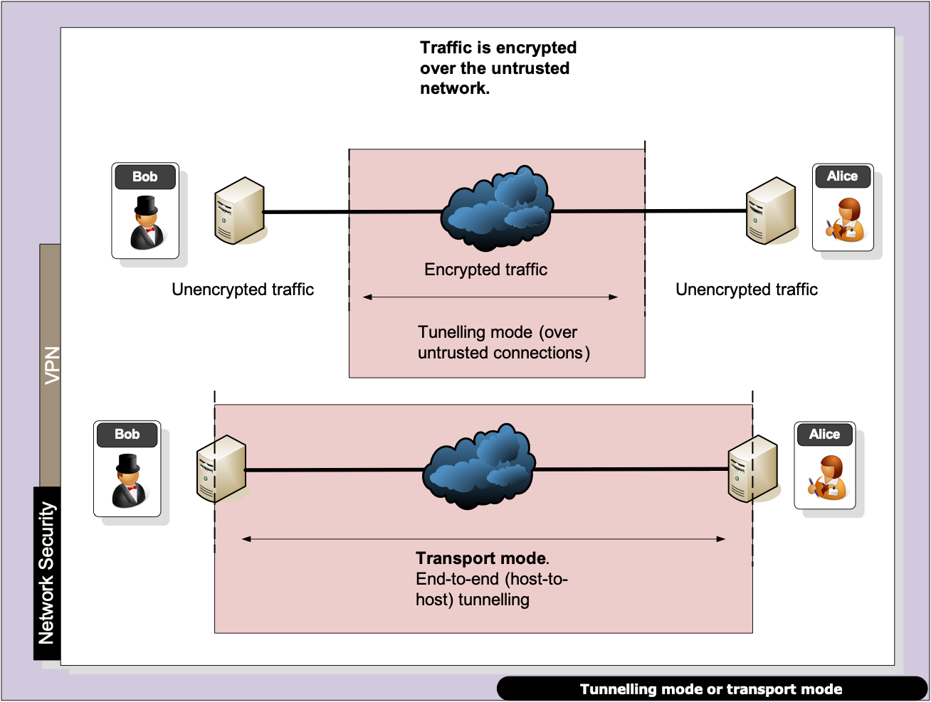

Slide 12
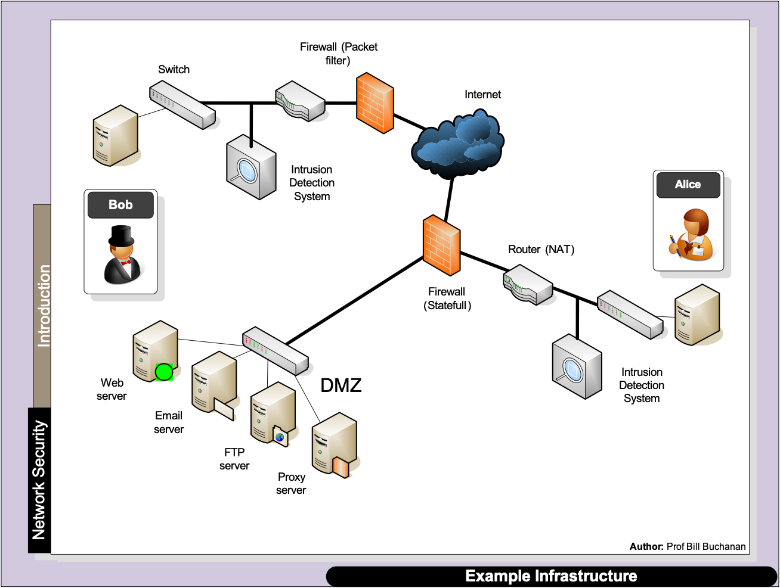

Slide 13
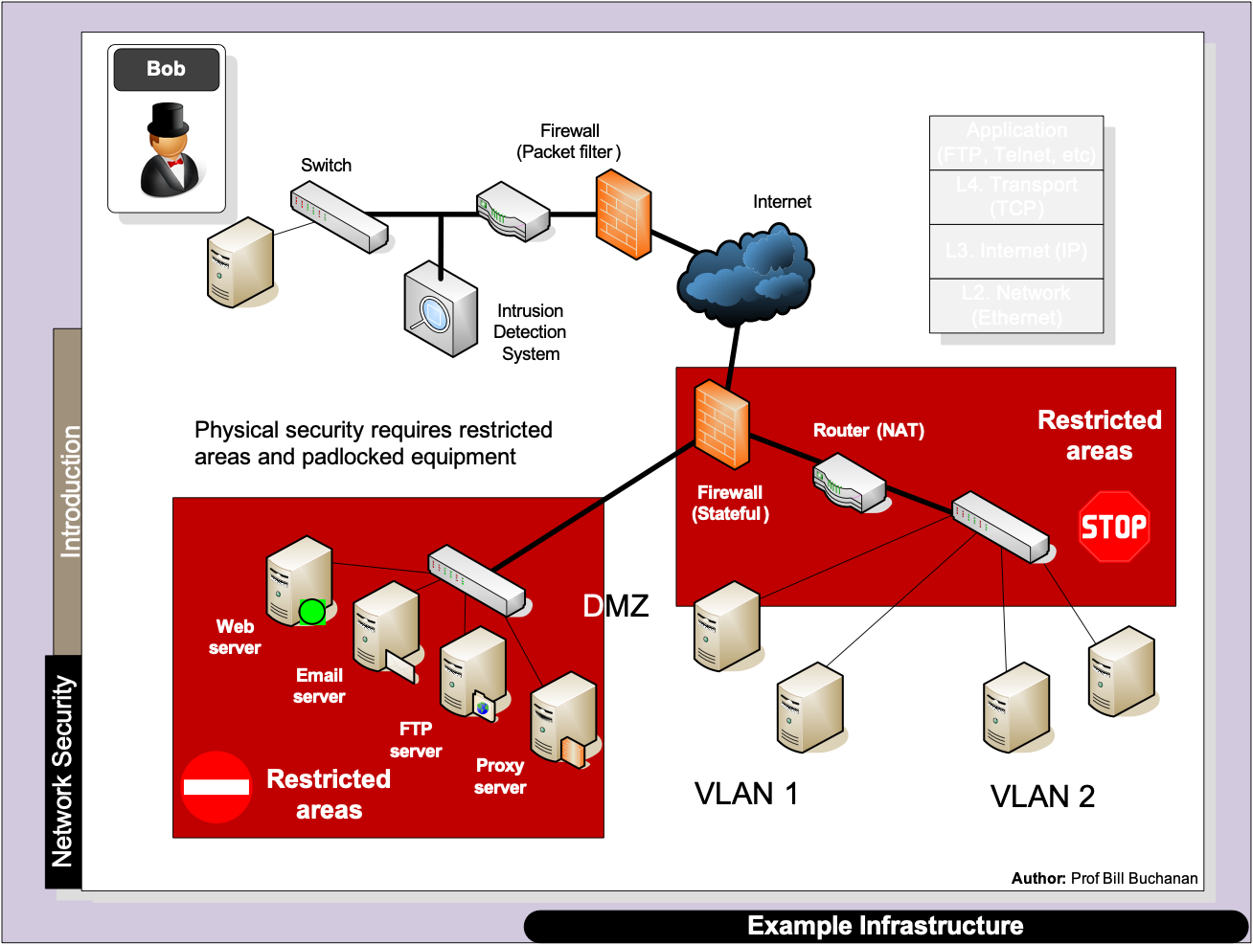

Slide 14
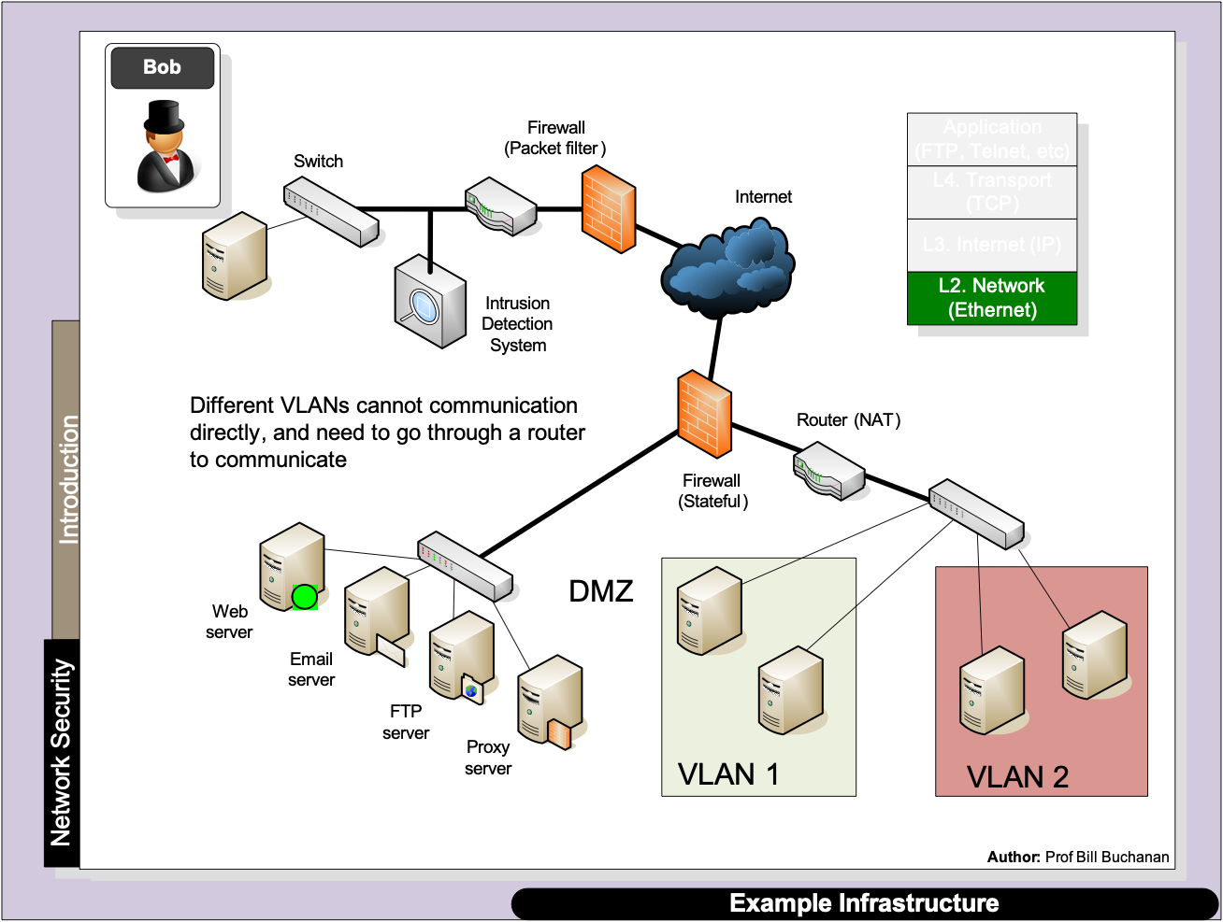

Slide 15
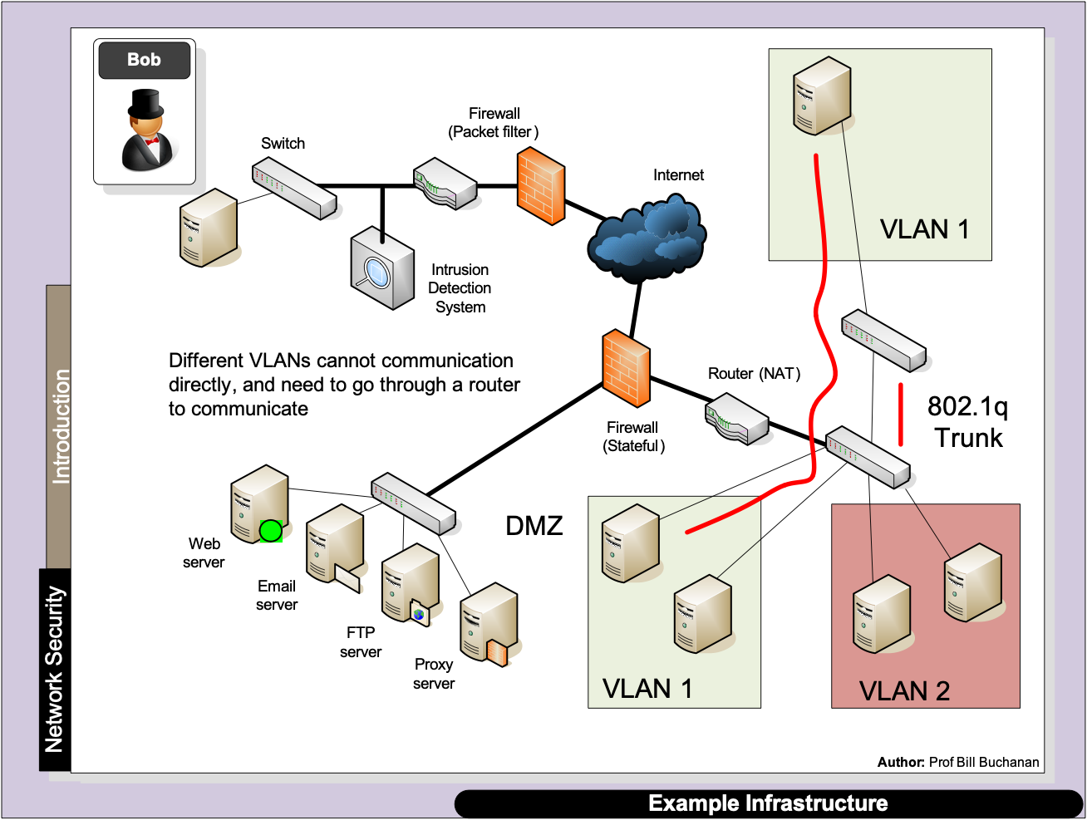

Slide 16
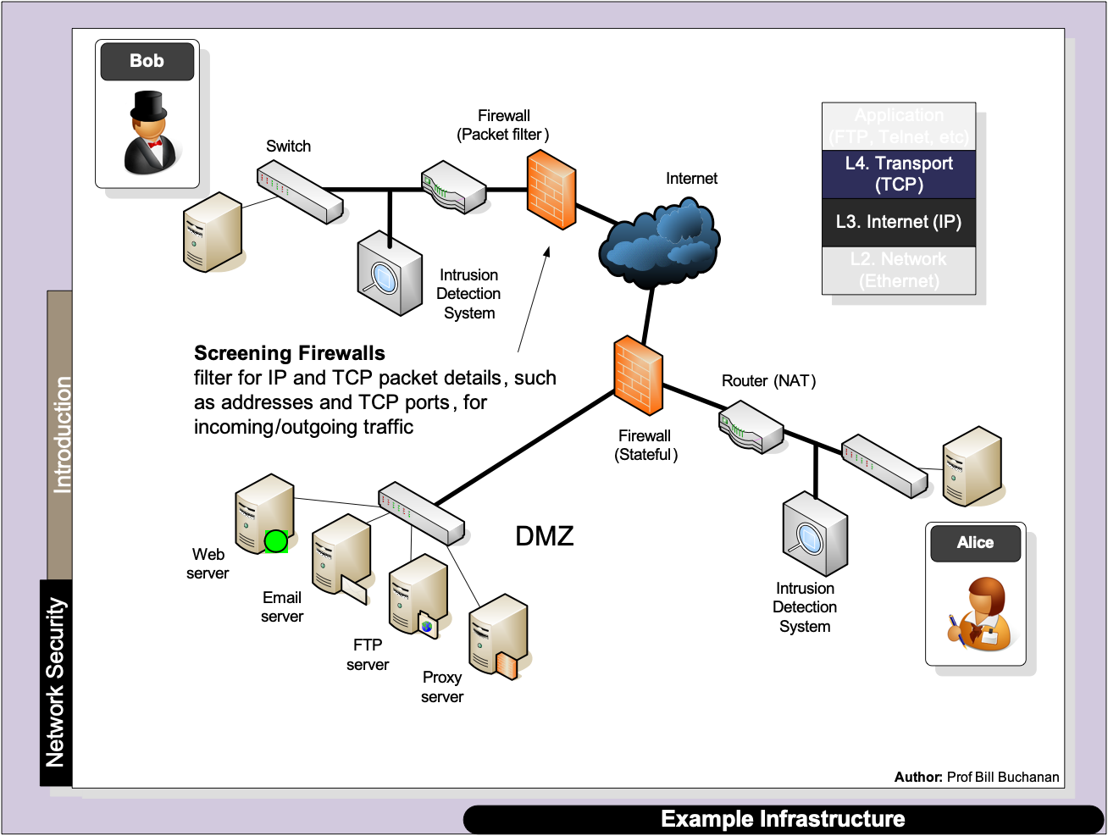

Slide 17
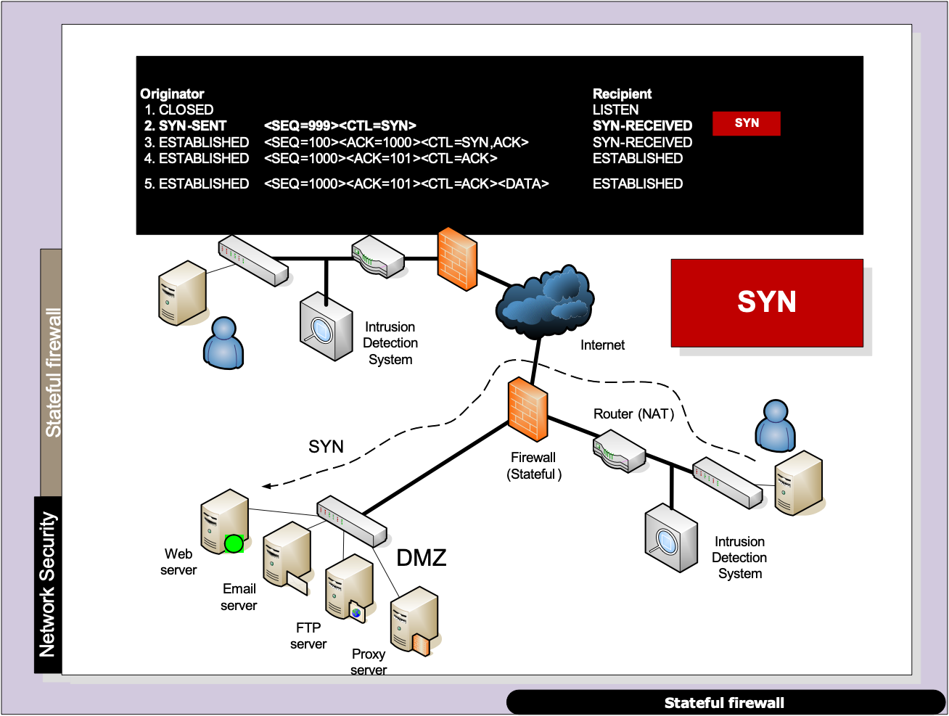

Slide 18
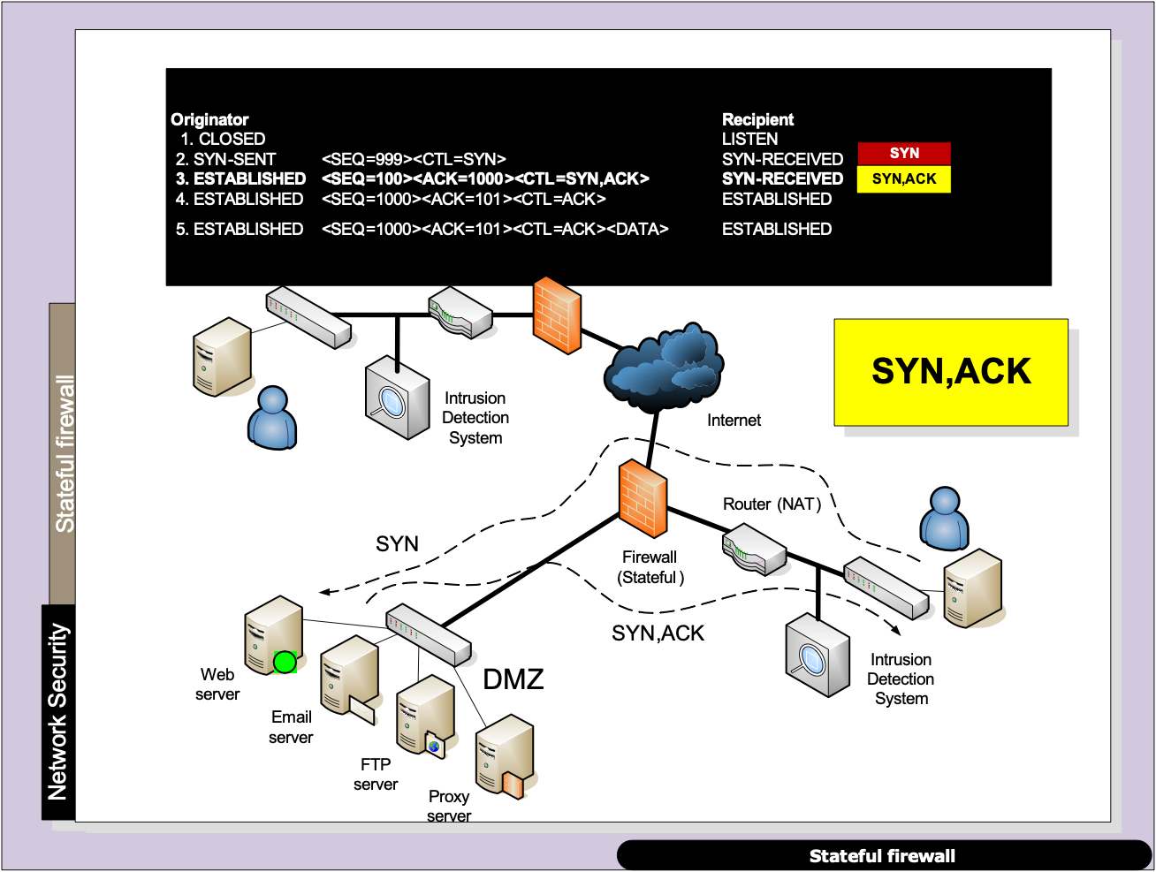

Slide 19
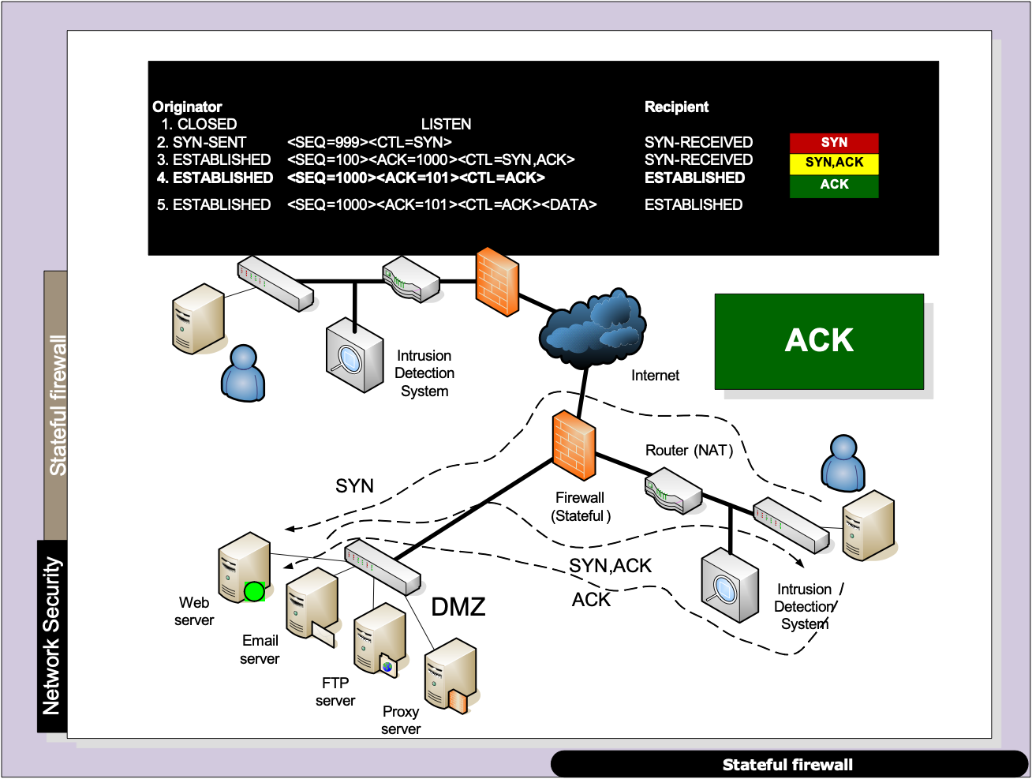

Slide 20
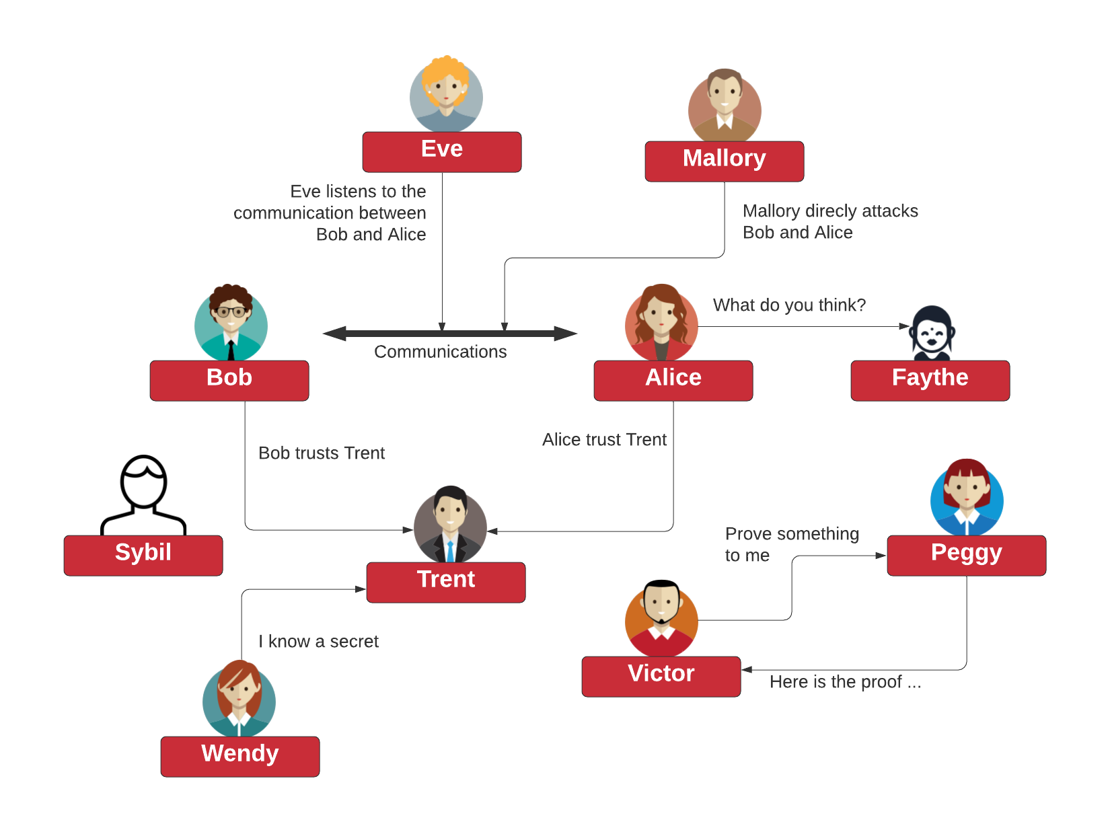
Tunnelling Scanners
SSL/TLS
VPN/IPSec Prof Bill Buchanan OBE http://asecuritysite.com/tunnelling

Slide 21
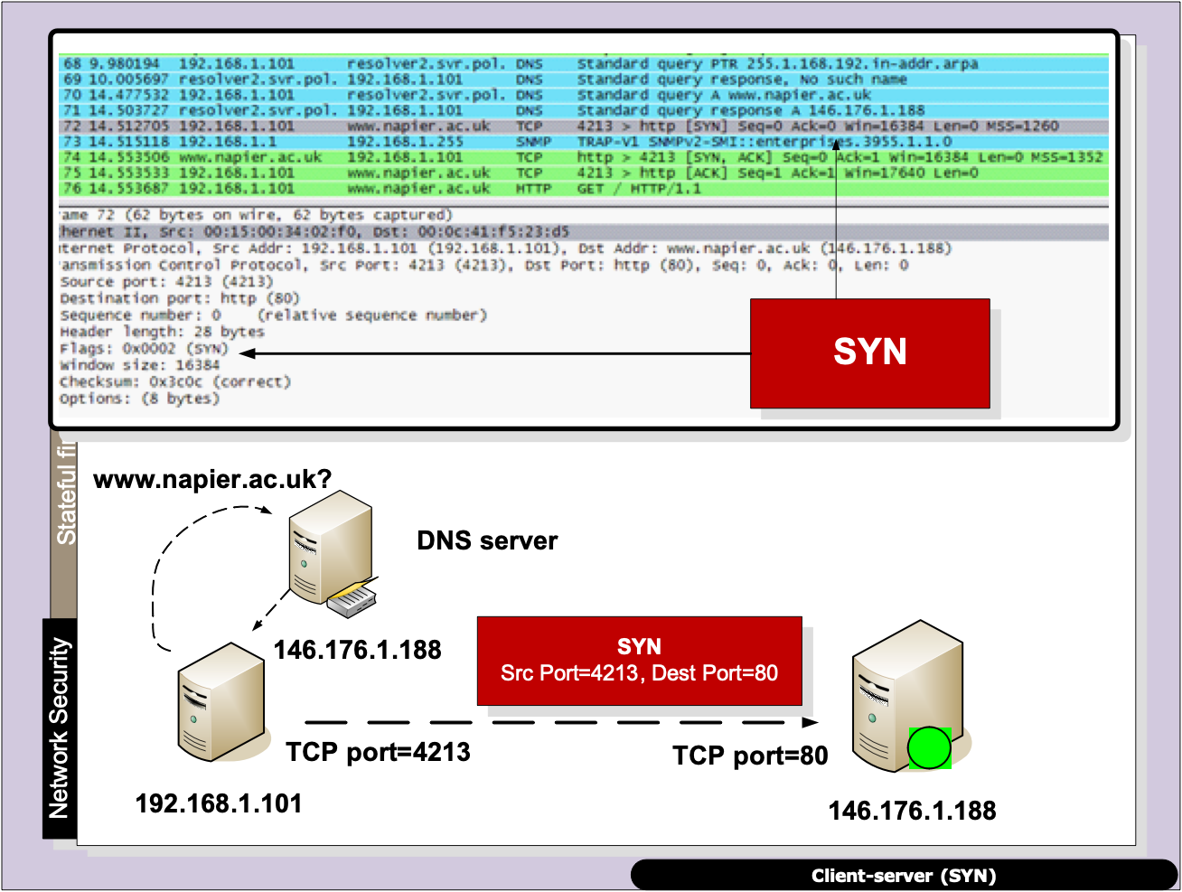

Slide 22
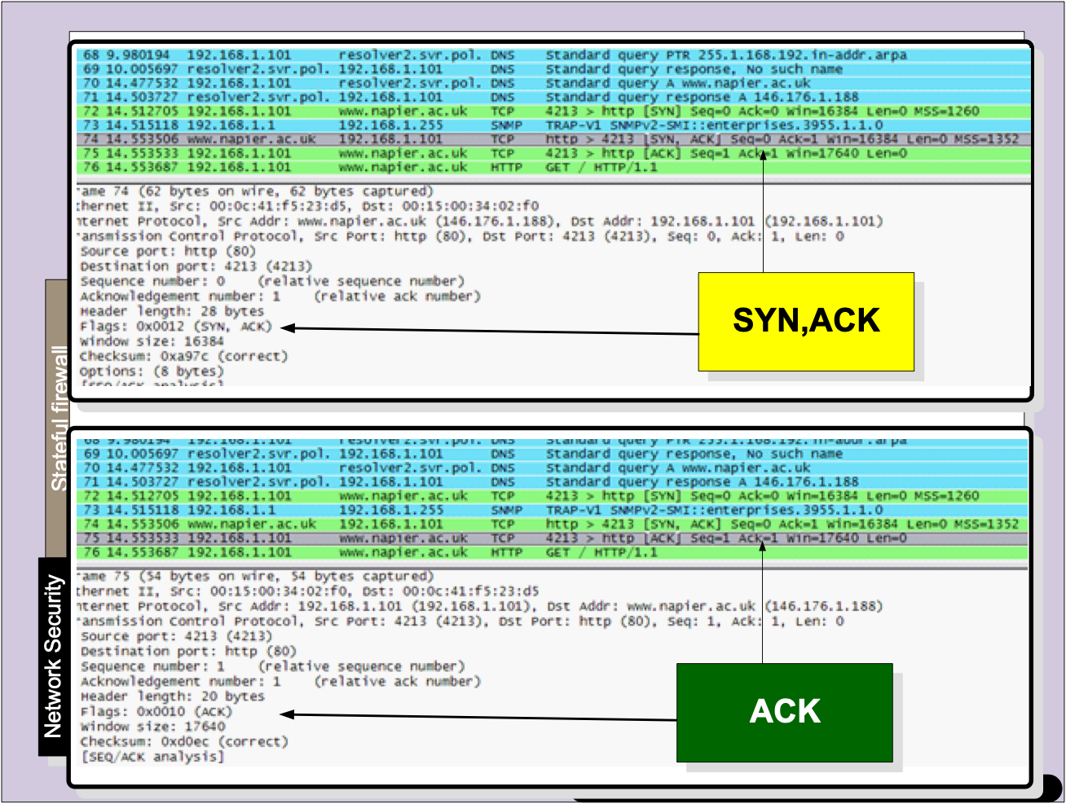

Slide 23
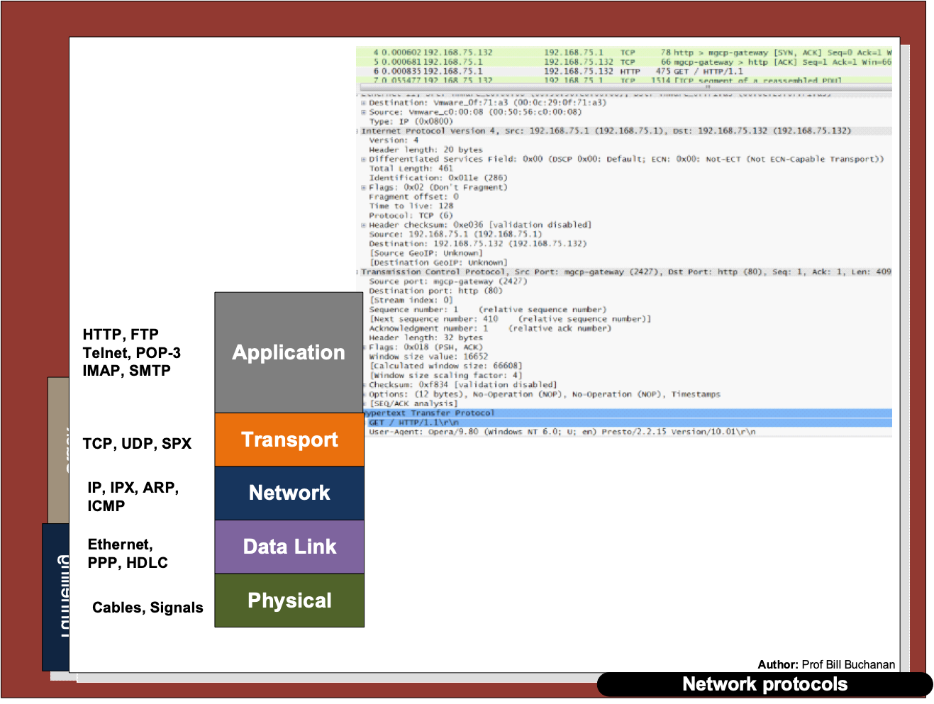

Slide 24
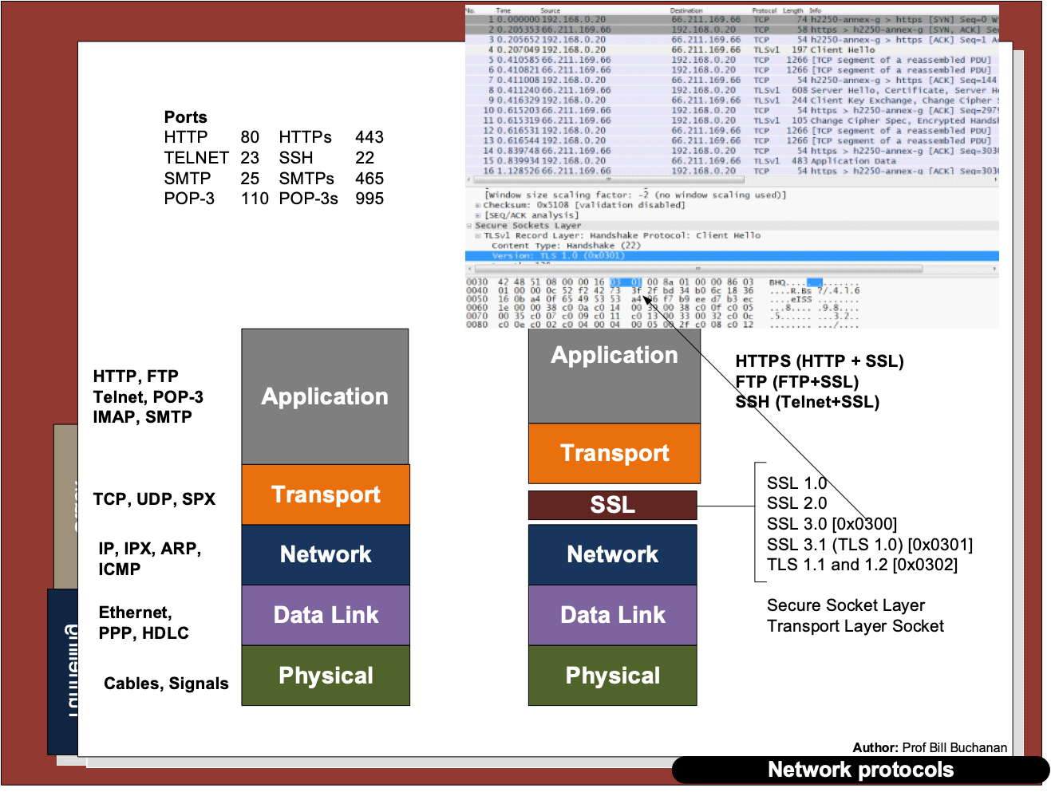

Slide 25
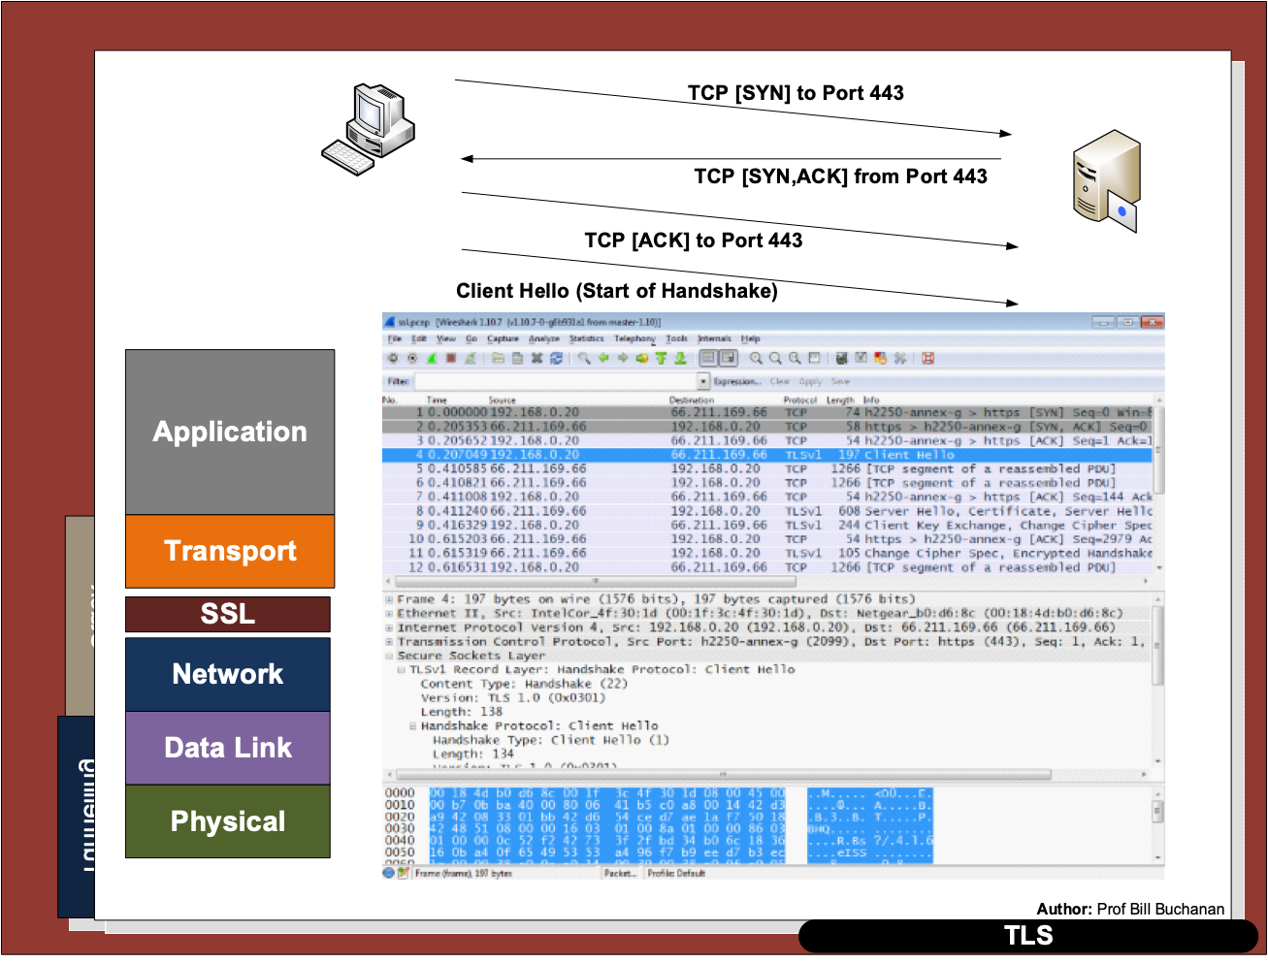

Slide 26
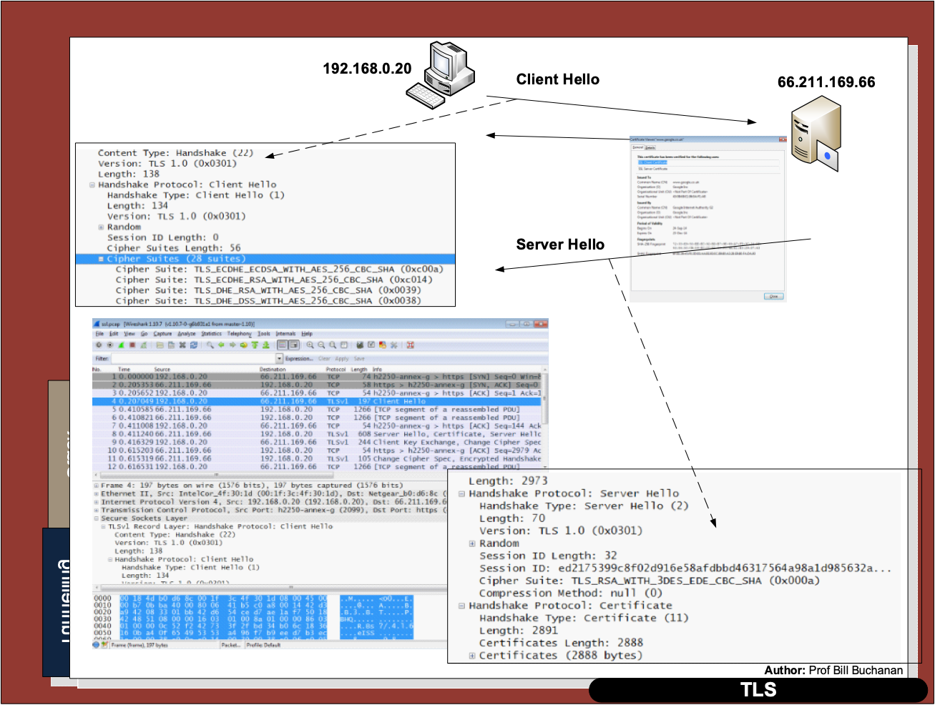

Slide 27
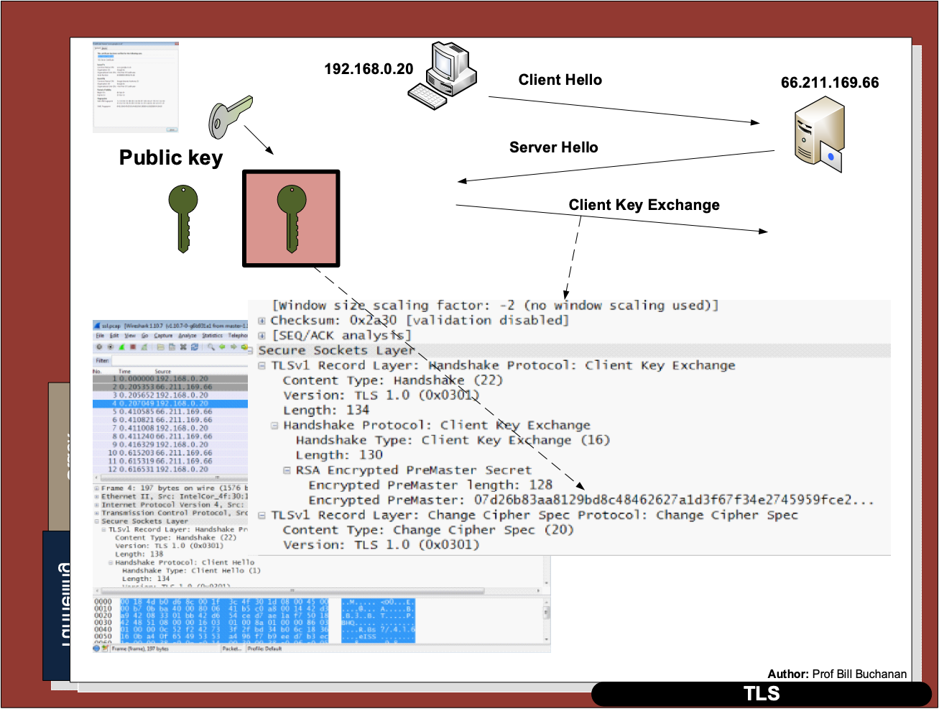

Slide 28
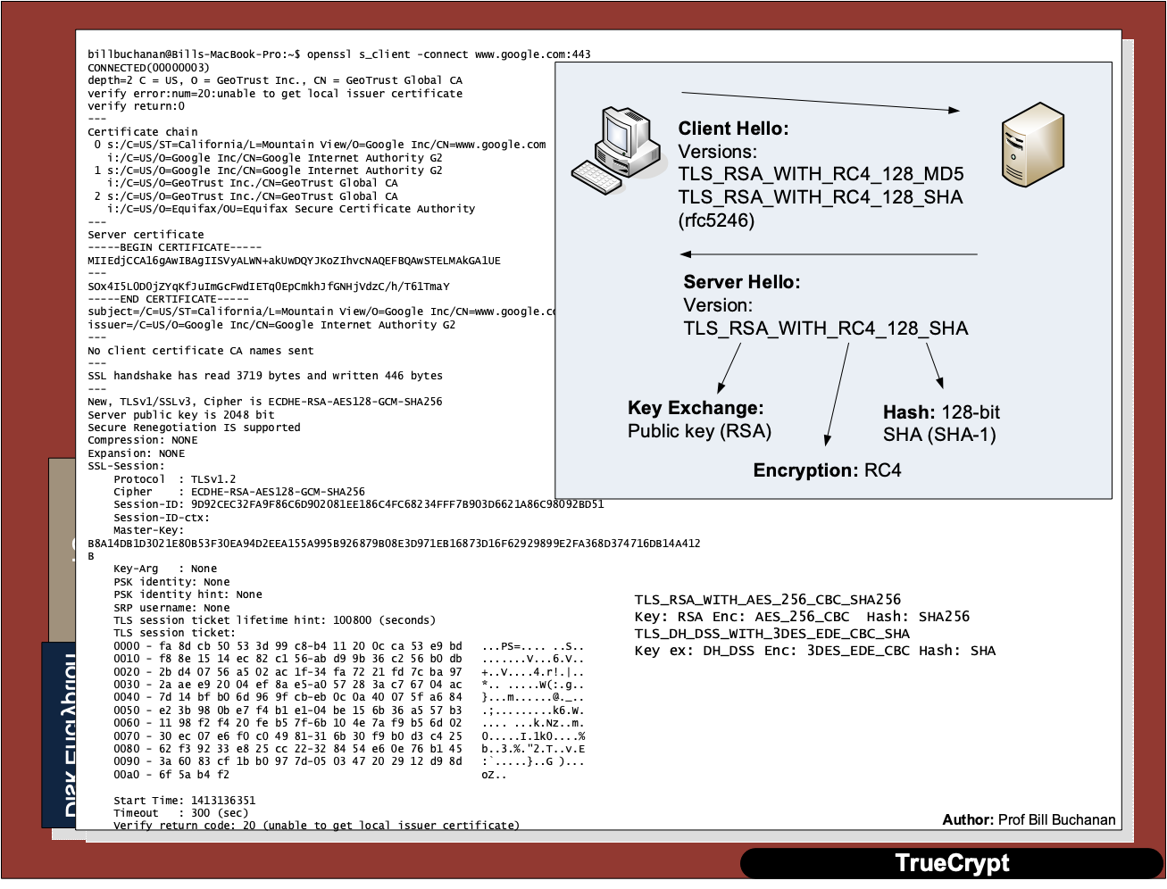

Slide 29
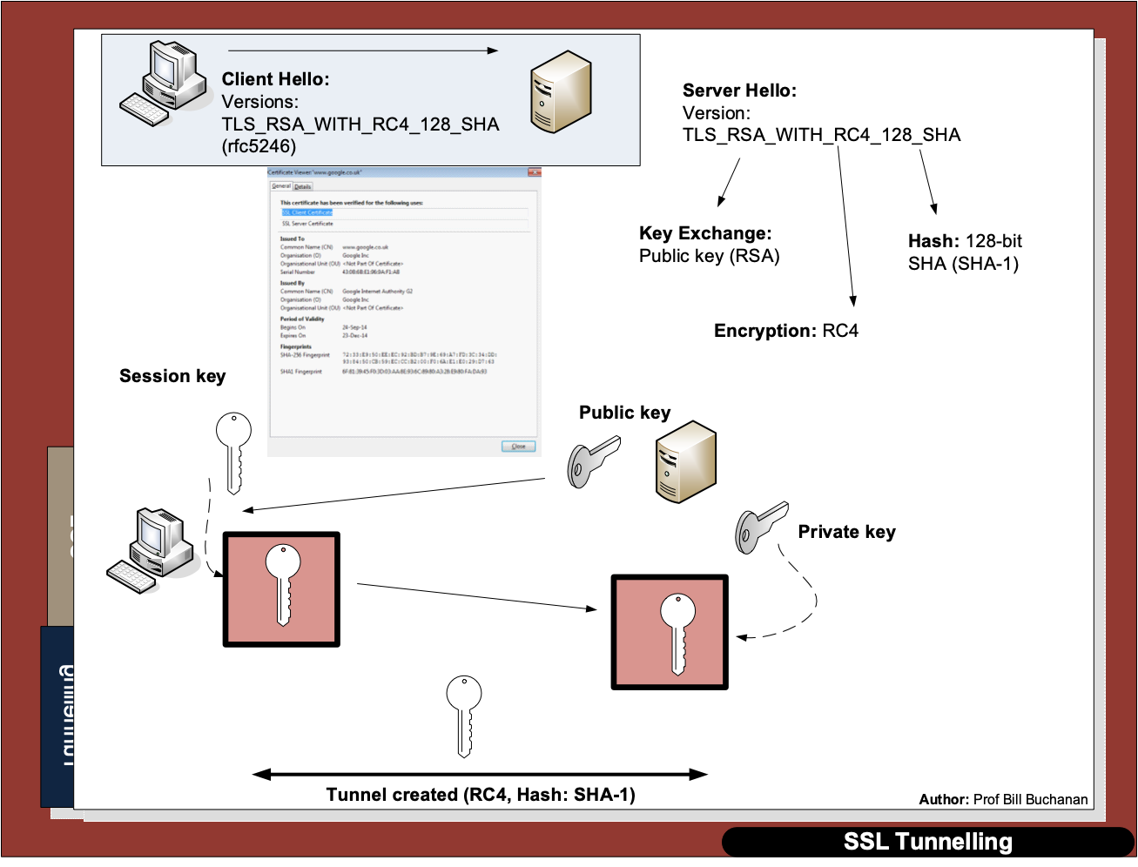

Slide 31
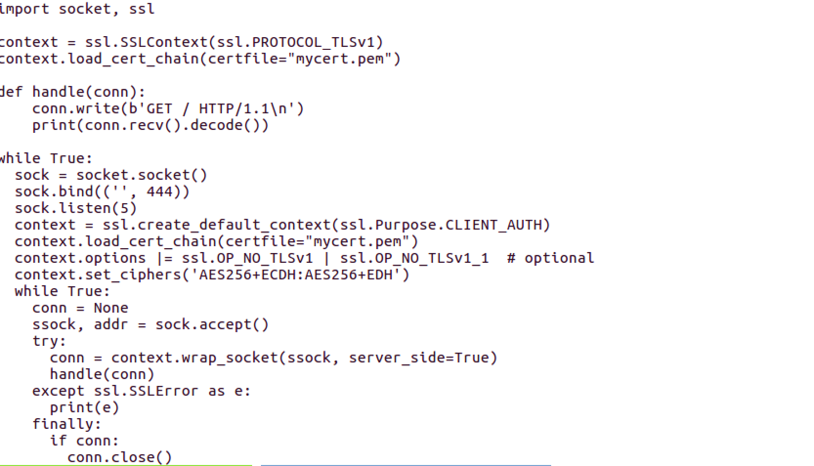
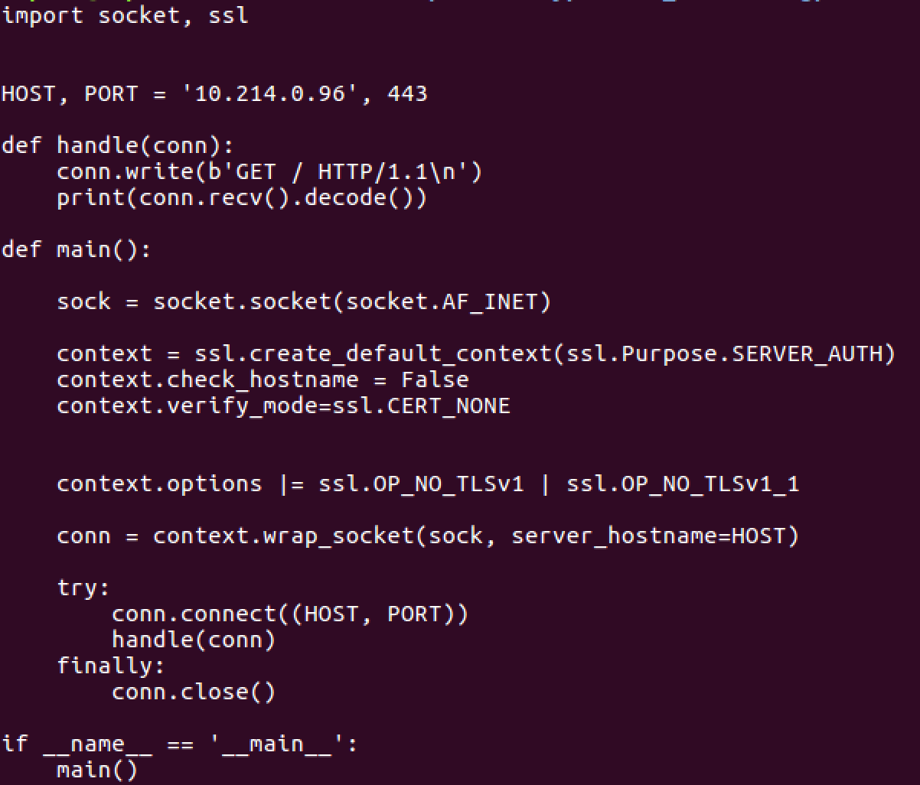
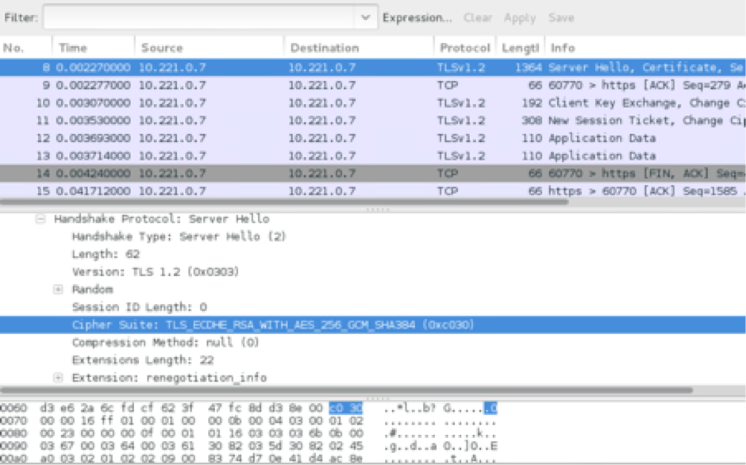

Slide 32
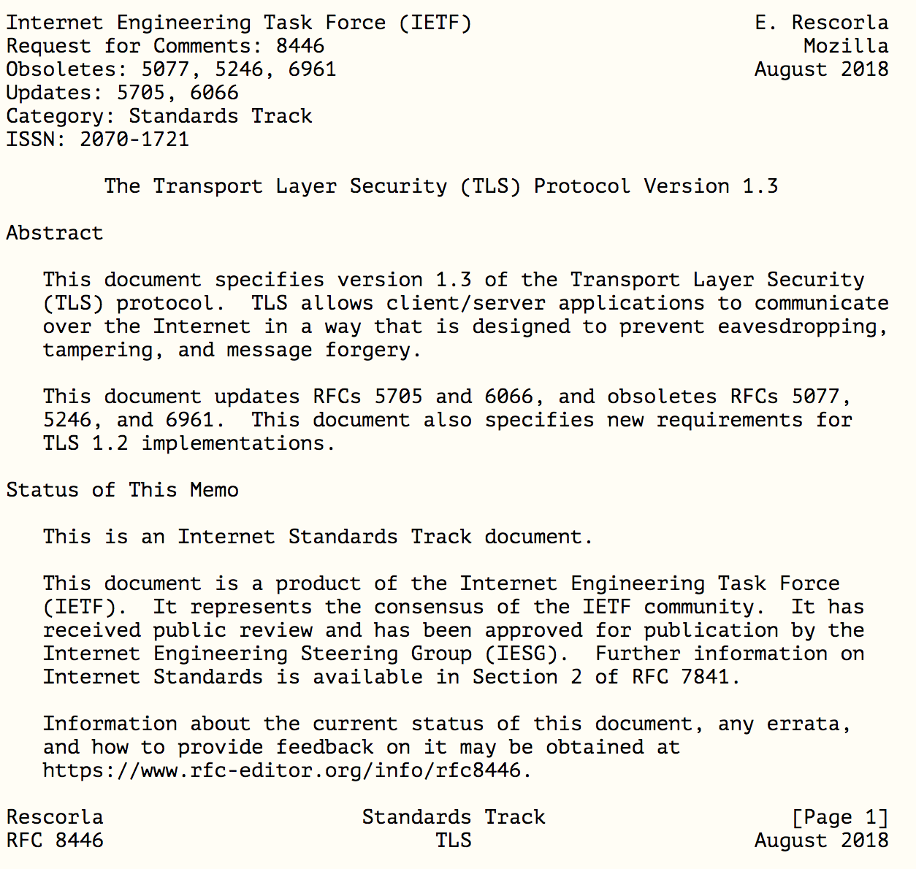

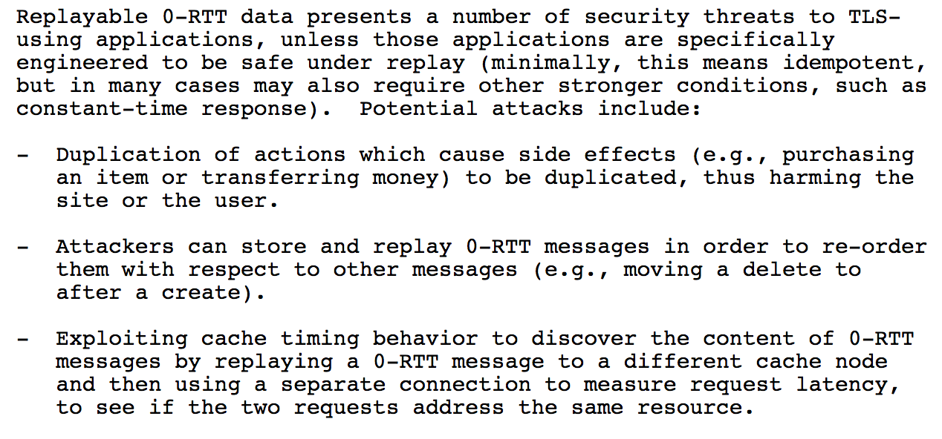
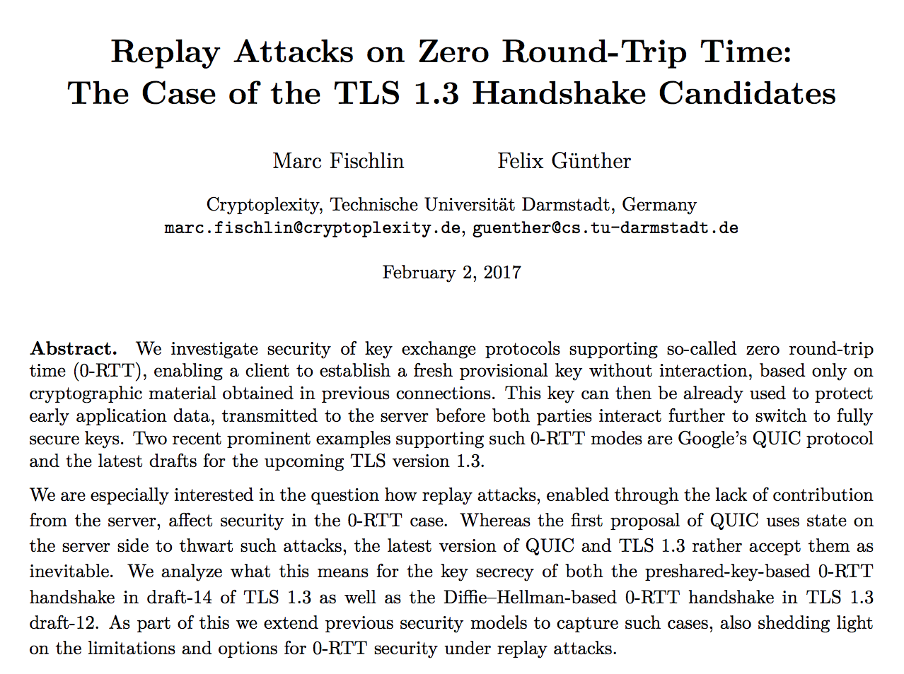

Slide 33
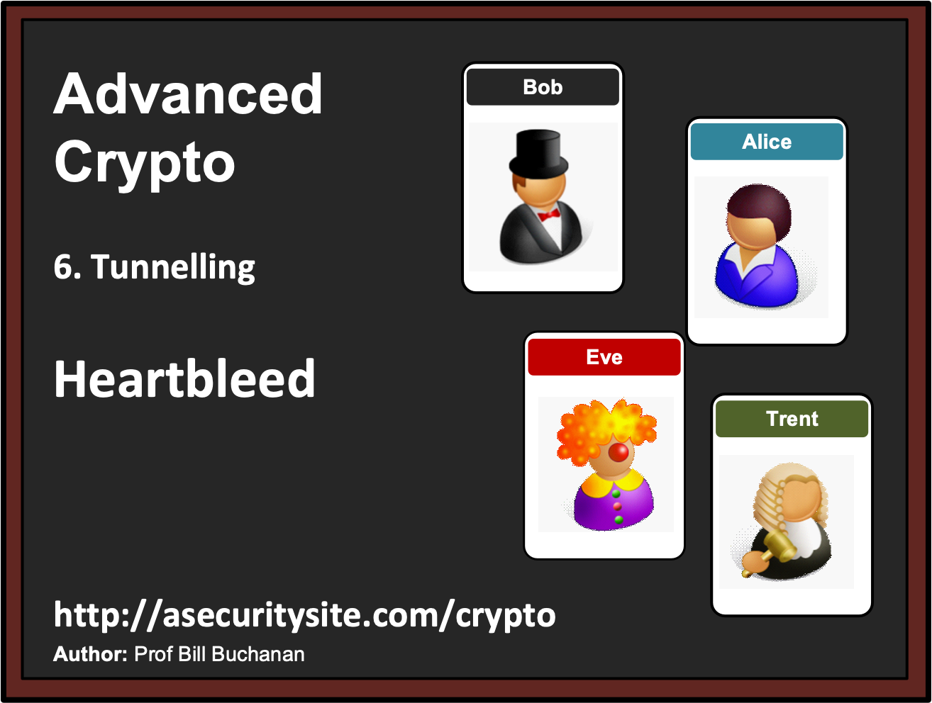

Slide 34
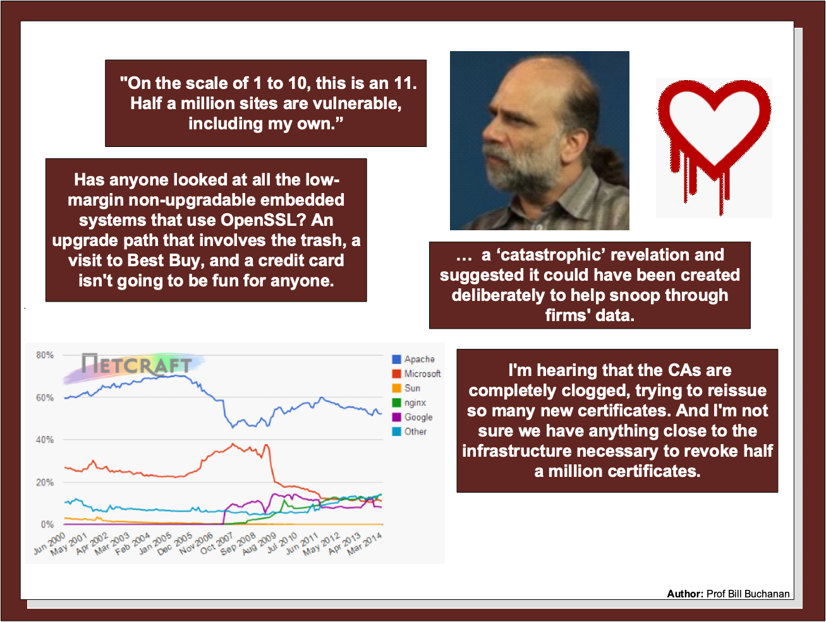

Slide 35
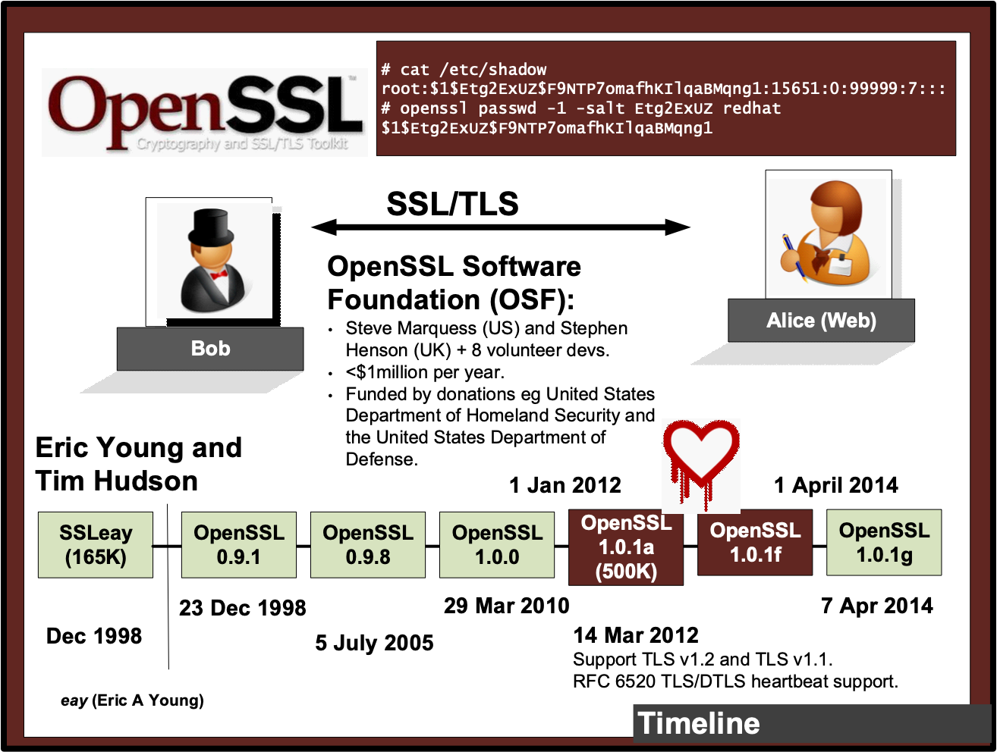

Slide 36
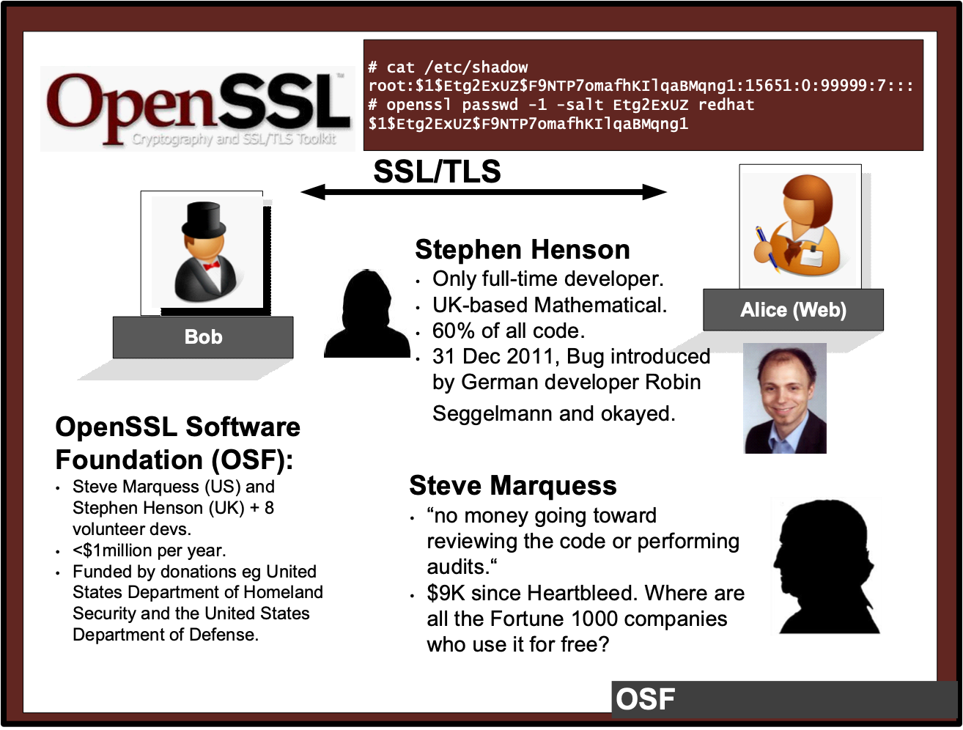

Slide 37
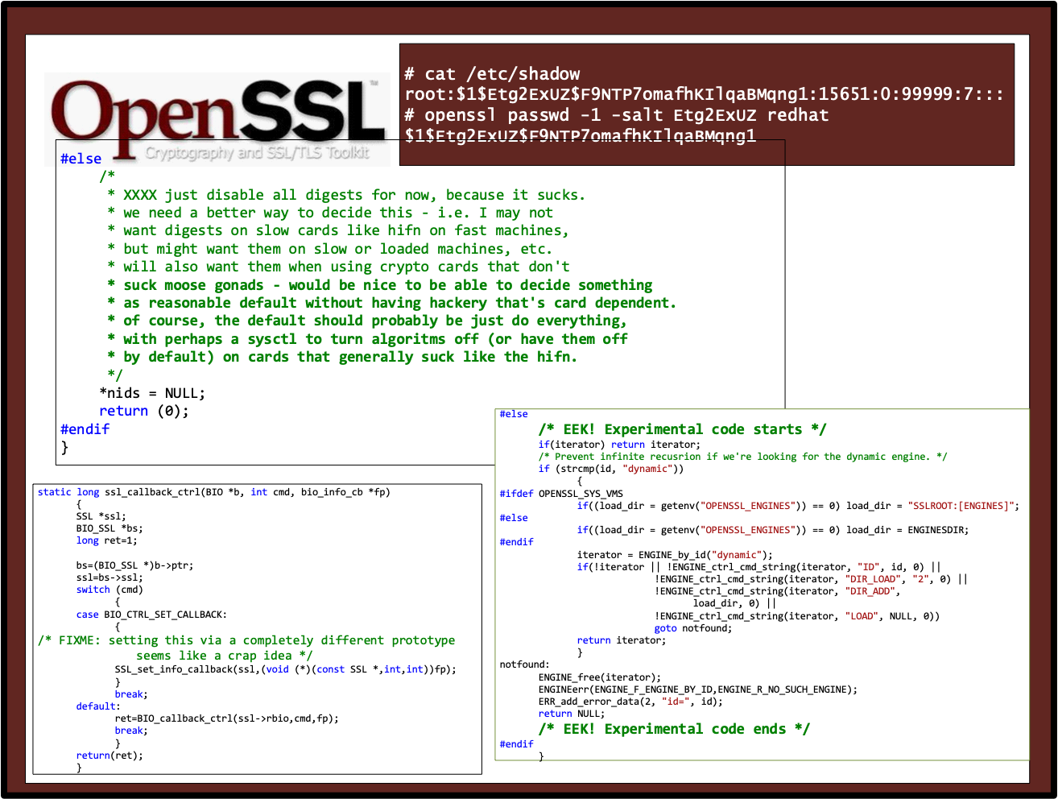

Slide 38
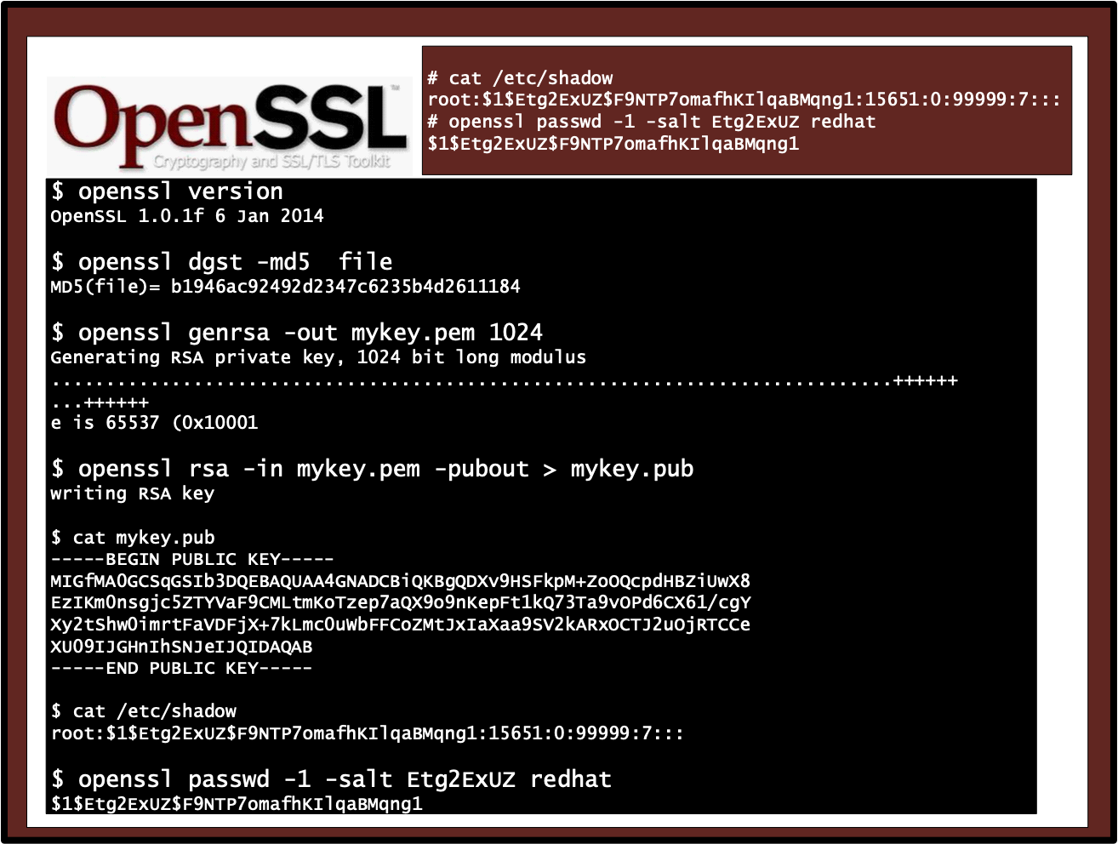

Slide 39
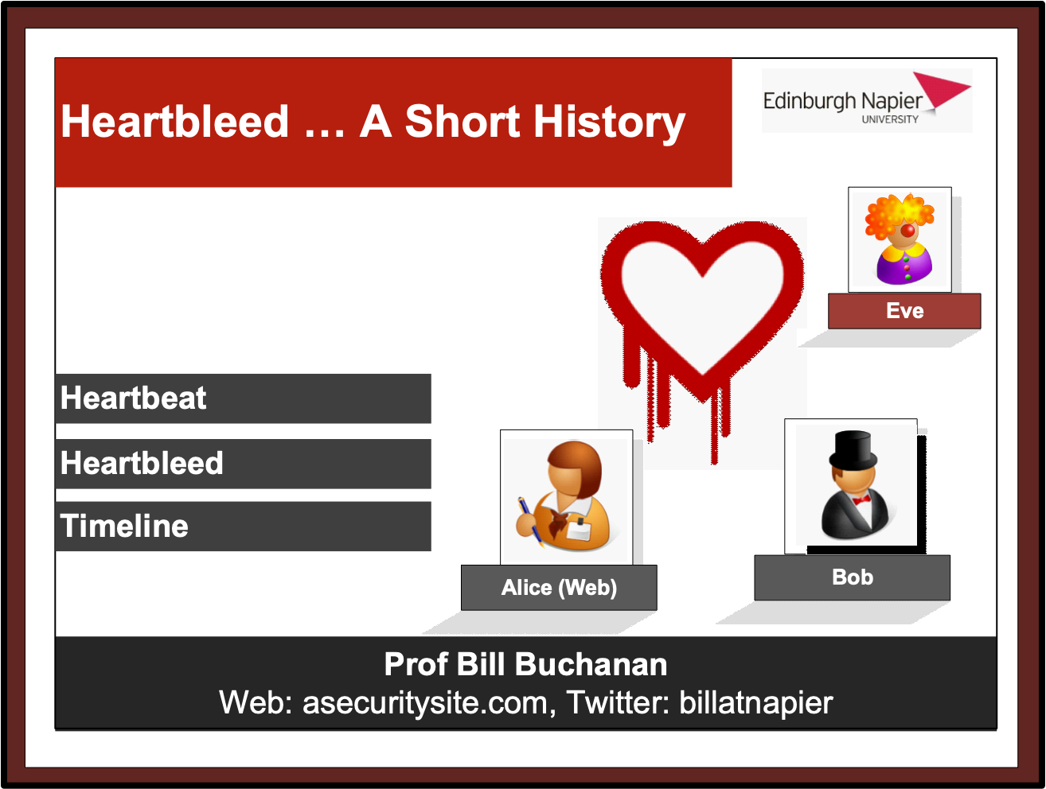

Slide 40
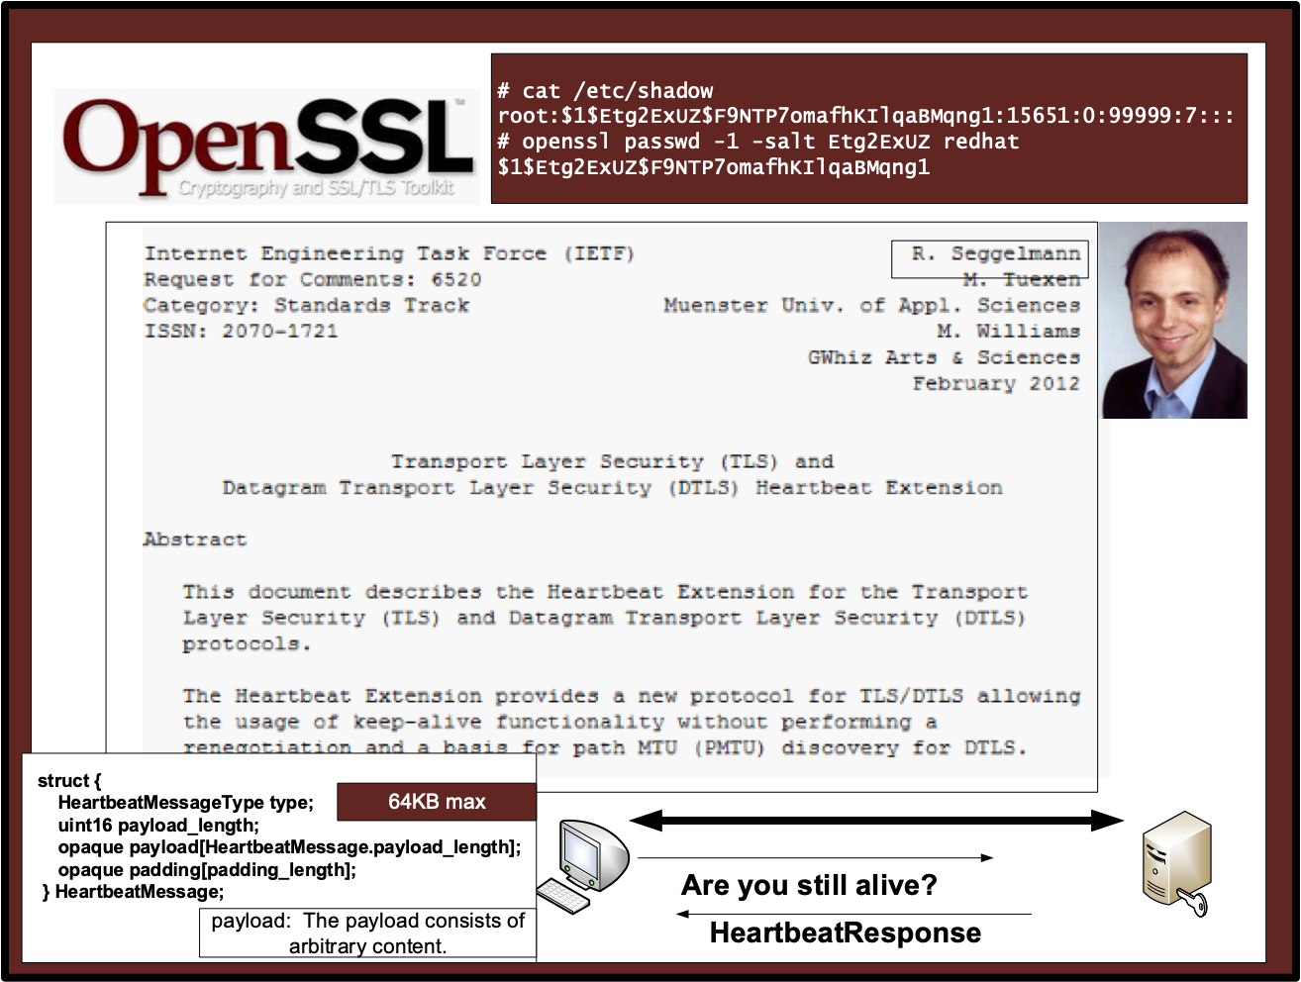

Slide 41
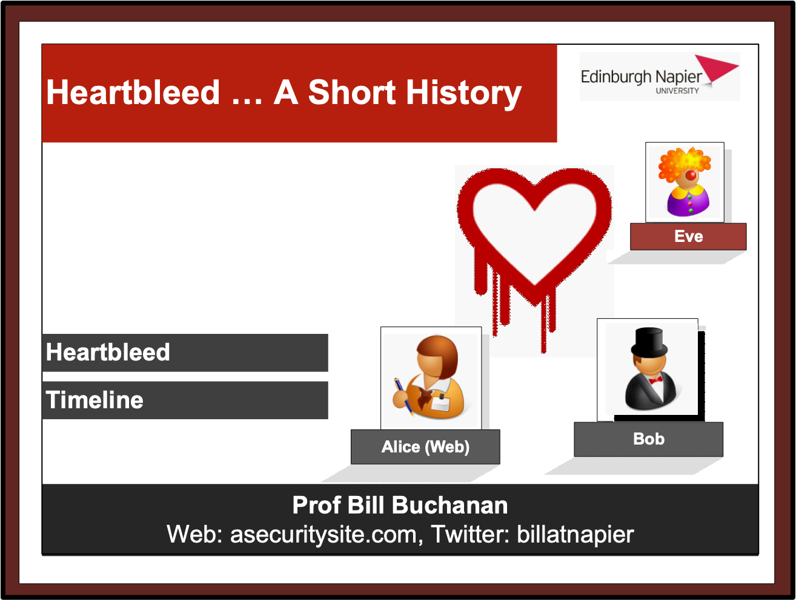

Slide 42
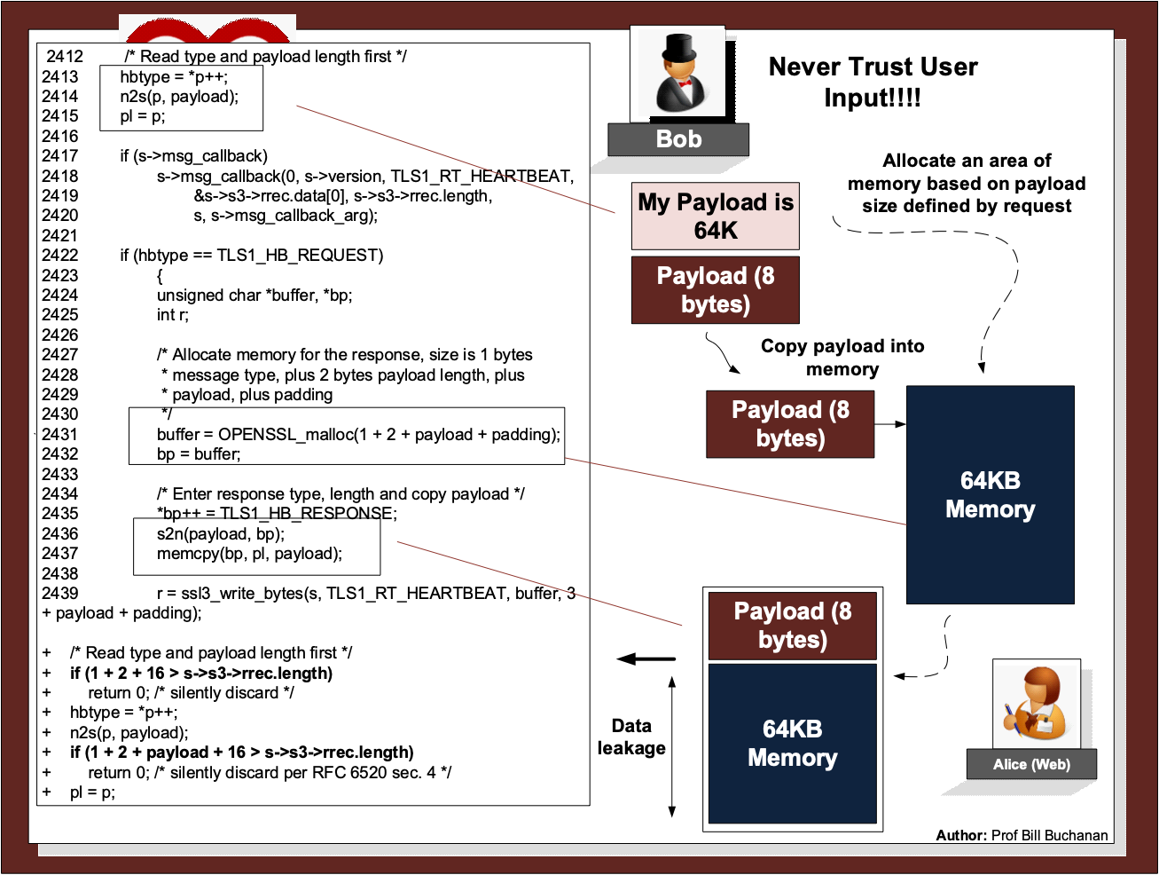

Slide 43
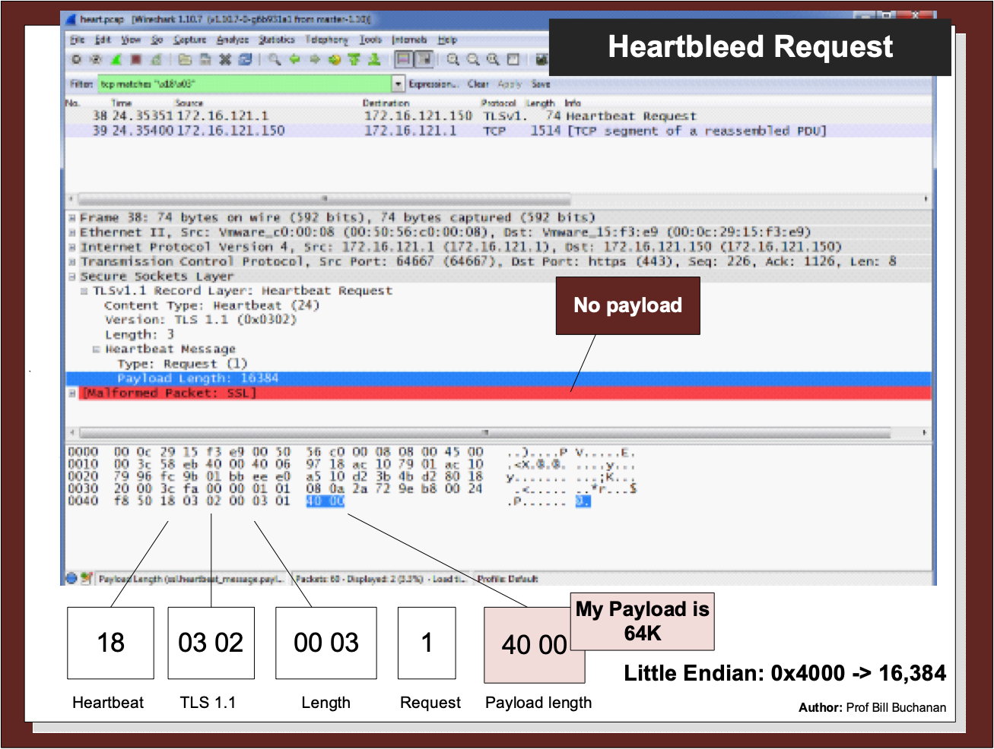

Slide 44
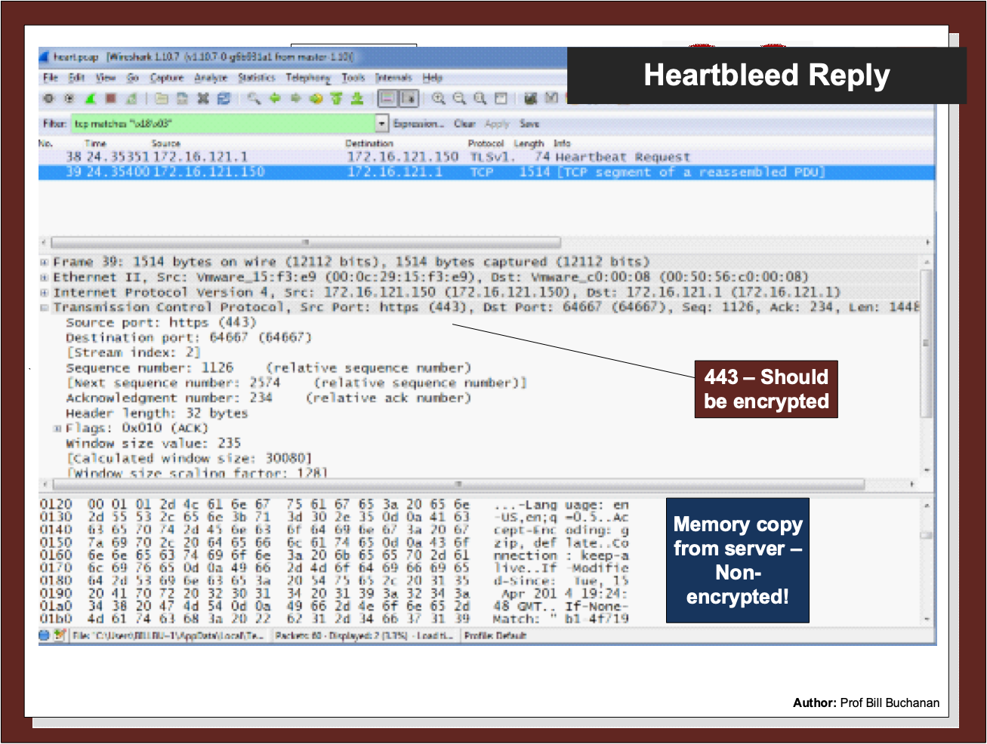

Slide 45
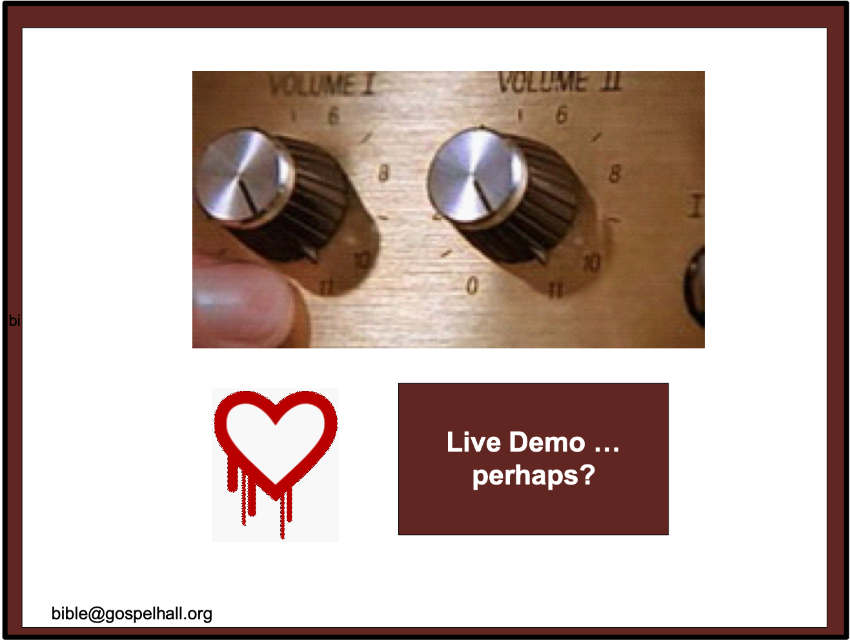

Slide 46
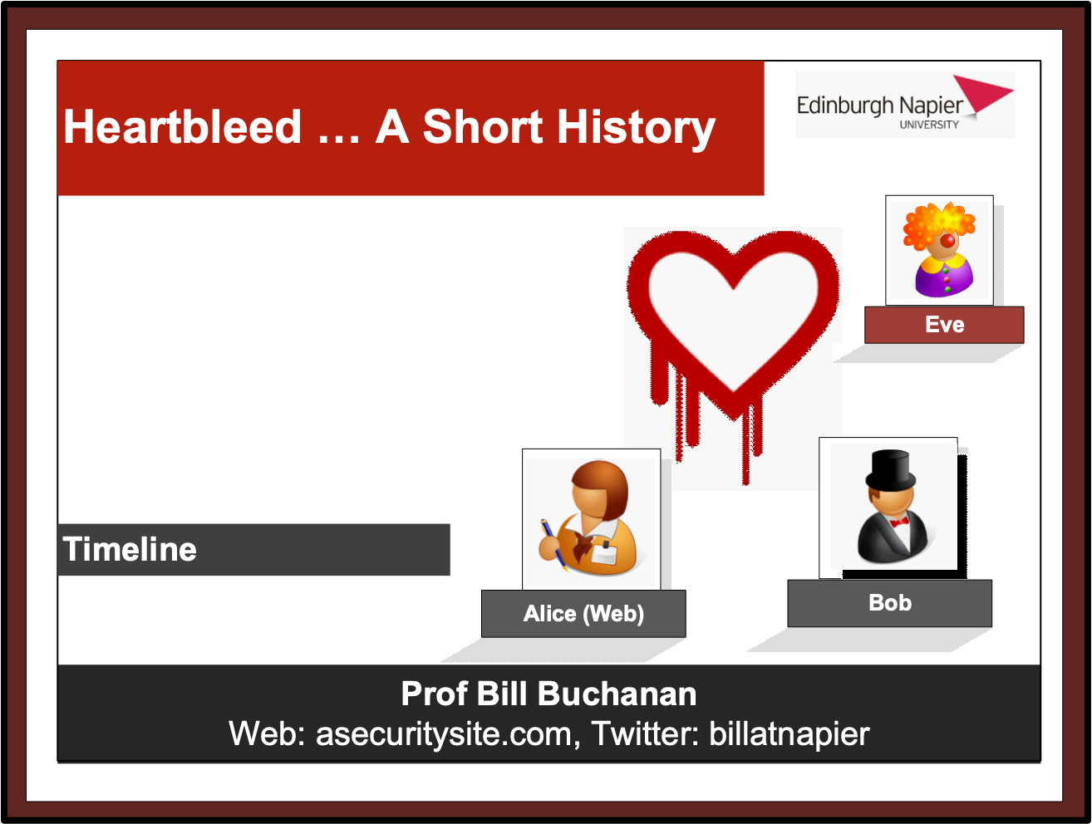

Slide 47
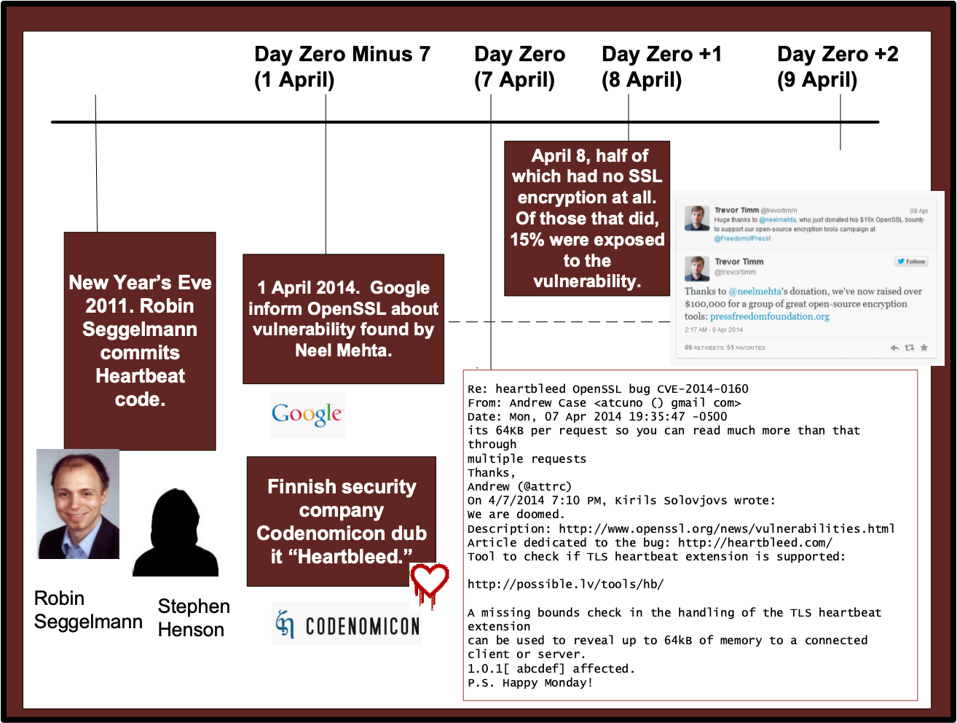

Slide 48
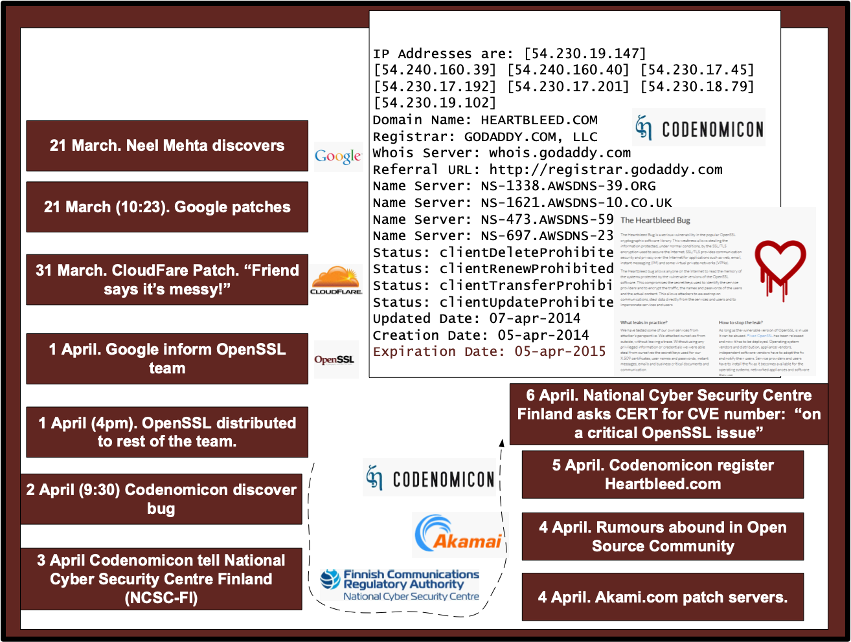

Slide 49


Slide 50


Slide 51


Slide 52



Slide 53


Slide 54


Slide 55
Tunnelling Basics. Scanners SSL/TLS Tor – Onion Routing VPN/IPSec Prof Bill Buchanan OBE http://asecuritysite.com/tunnelling

Slide 56

Tor – Onion Routing

Slide 57
Tunnelling Basics. Scanners SSL/TLS Tor – Onion Routing Wireguard/MLS/VPN/IPSec Prof Bill Buchanan OBE http://asecuritysite.com/tunnelling

Slide 58

WireGuard was created by Jason A. Donenfeld in 2016 and has now been ported to Windows, Linux, Android and iOS. At its core is the usage of the more modern cryptography methods such as Curve25519 (for ECDH — Elliptic Curve Diffie Hellman — key exchange), ChaCha20 (for fast symmetric key encryption), Poly1305 (for AEAD methods), BLAKE2s (for hashing), SipHash25 (for hashtables) and HKDF (for key derivations). It also uses a connection-less approach (with UDP), and which is generally faster than TCP-based methods.
Wireguard

Slide 59

Messaging Layer Security (MLS) was initially proposed in 2016 and integrates end-to-end encrypting of messages. It has been defined by the IETF MLS working group, and integrates message confidentiality, message integrity and authentication, membership authentication, asynchronicity, forward secrecy, post-compromise security, and scalability We can use X25519_AES128GCM_SHA256_Ed25519, and which integrates 128-bit (32 bytes) AES with GCM mode. Other modes are: P256_AES128GCM_SHA256_P256, X25519_CHACHA20POLY1305_SHA256_Ed25519 and P521_AES256GCM_SHA512_P521.
MLS

Slide 60


Slide 61


Slide 62


Slide 63


Slide 64


Slide 65


Slide 66


Slide 67


Slide 68


Slide 69


Slide 70


Slide 71


Slide 72


Slide 73
Tunnelling Scanners
SSL/TLS
VPN/IPSec Prof Bill Buchanan OBE http://asecuritysite.com/tunnelling

